Slide 1
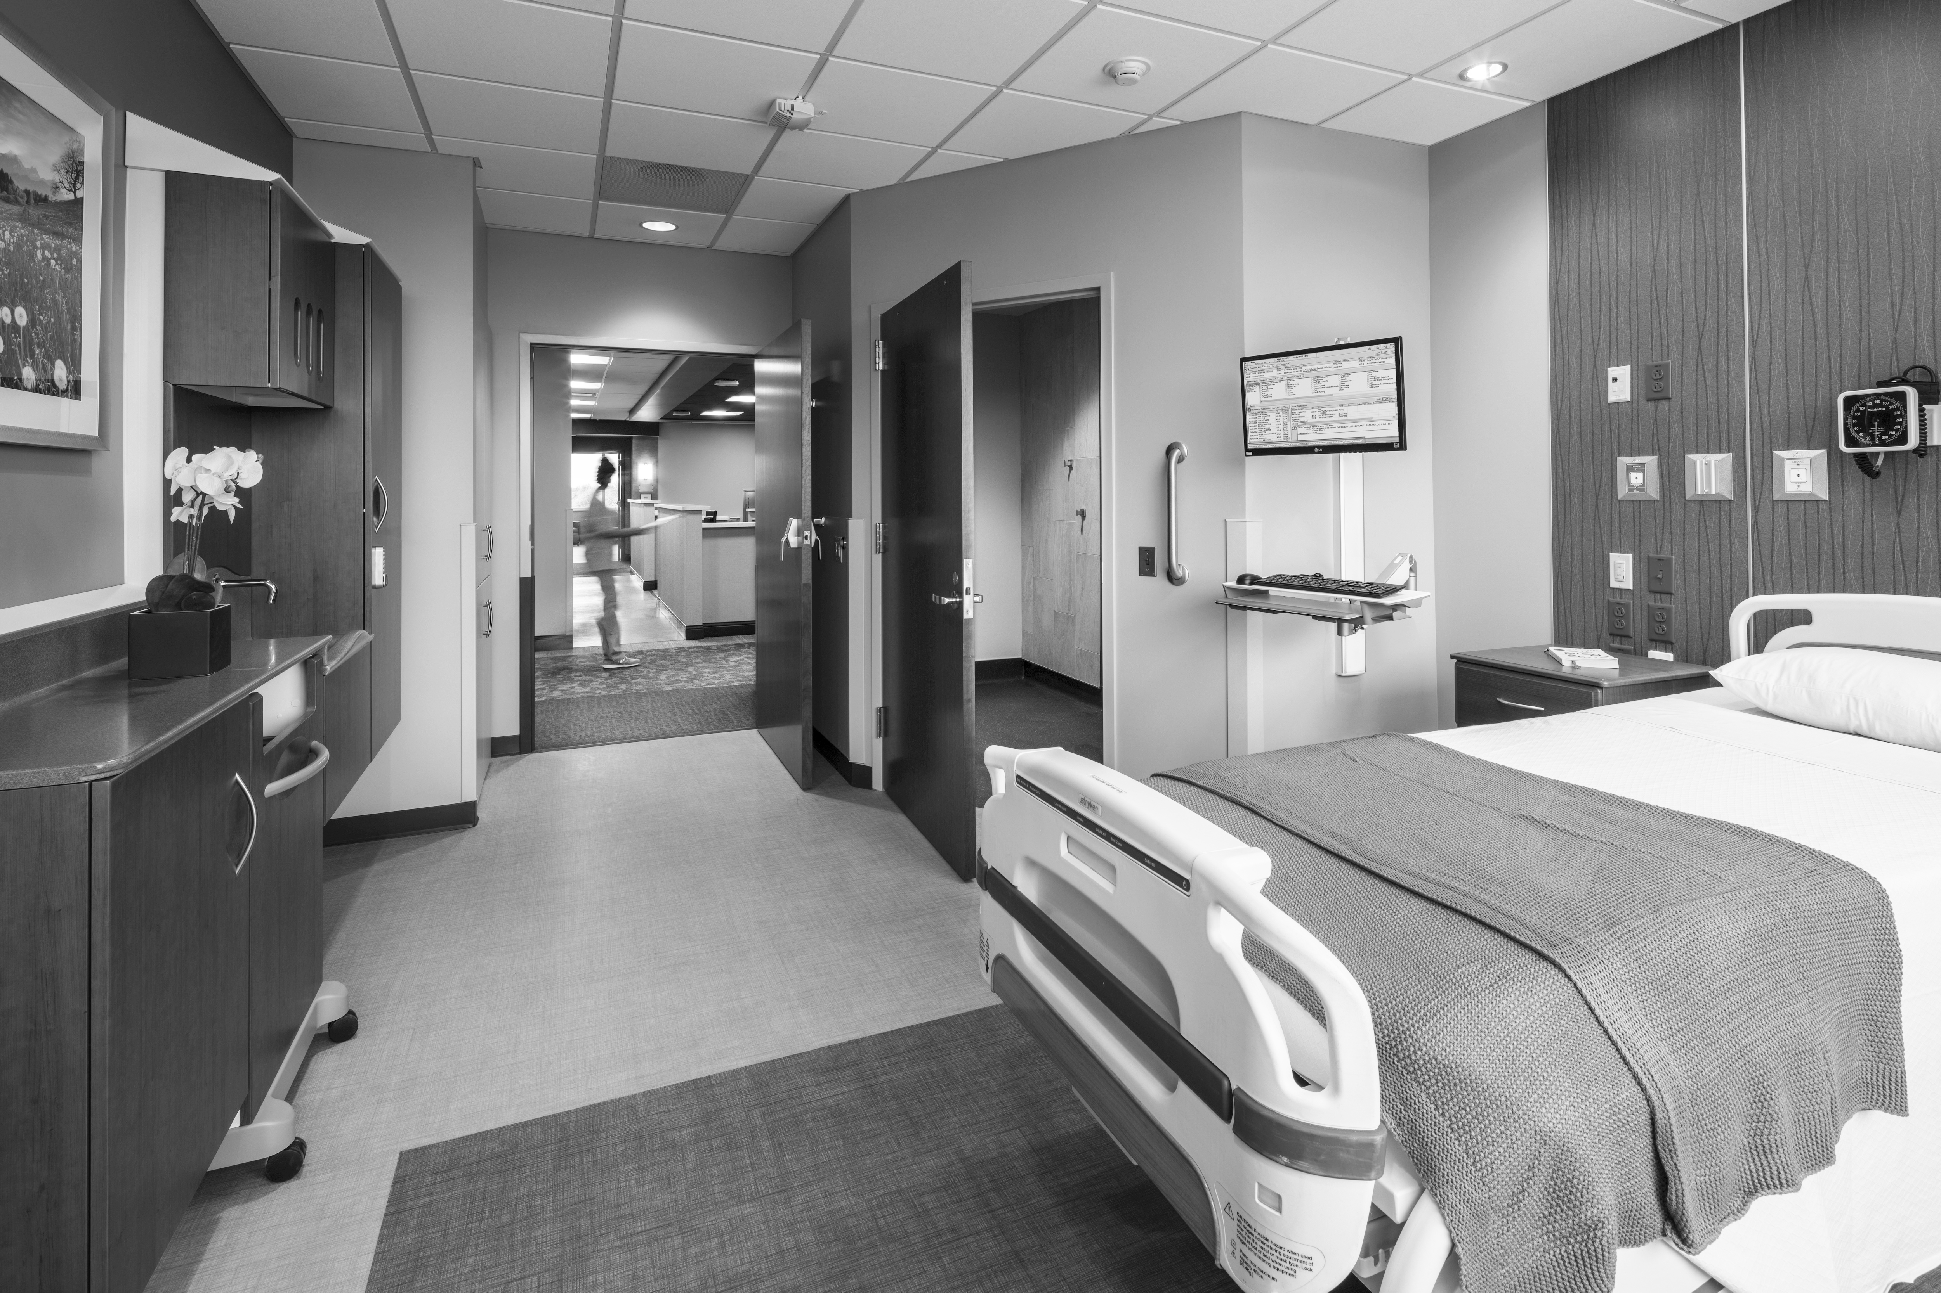


DOORS AND HARDWARE FOR HEALTHCARE
PRESENTERS:
Greg Meyer AIA, LEED AP Architect
Flad Architects
Ramon Moll AIA, NCARB Architect
Flad Architects
march 12, 2020 | spring seminar |

Slide 2
Understand the fire and smoke requirements for door openings in relationship to location.
Understand the requirements for doors in the means of egress and options for securing them for the health, safety, and welfare of the patients.
Be able to integrate door requirements of the various doors into the project.
Be able to develop a correct program of testing and maintenance for the doors that will be installed in the project.
Learning Objectives

Slide 3

Doors and Hardware for Healthcare
p 3

Slide 4
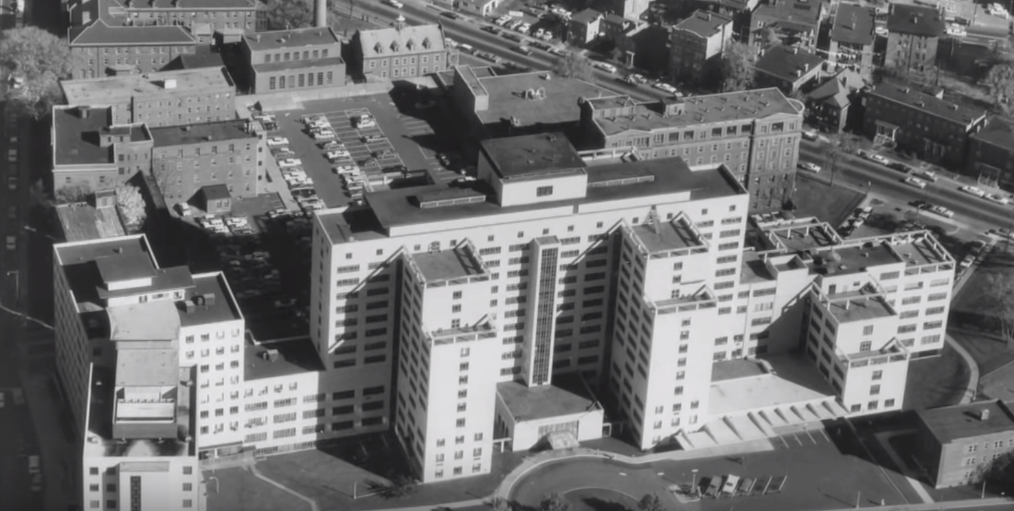
Hartford Hospital, Connecticut – 1961

Slide 5
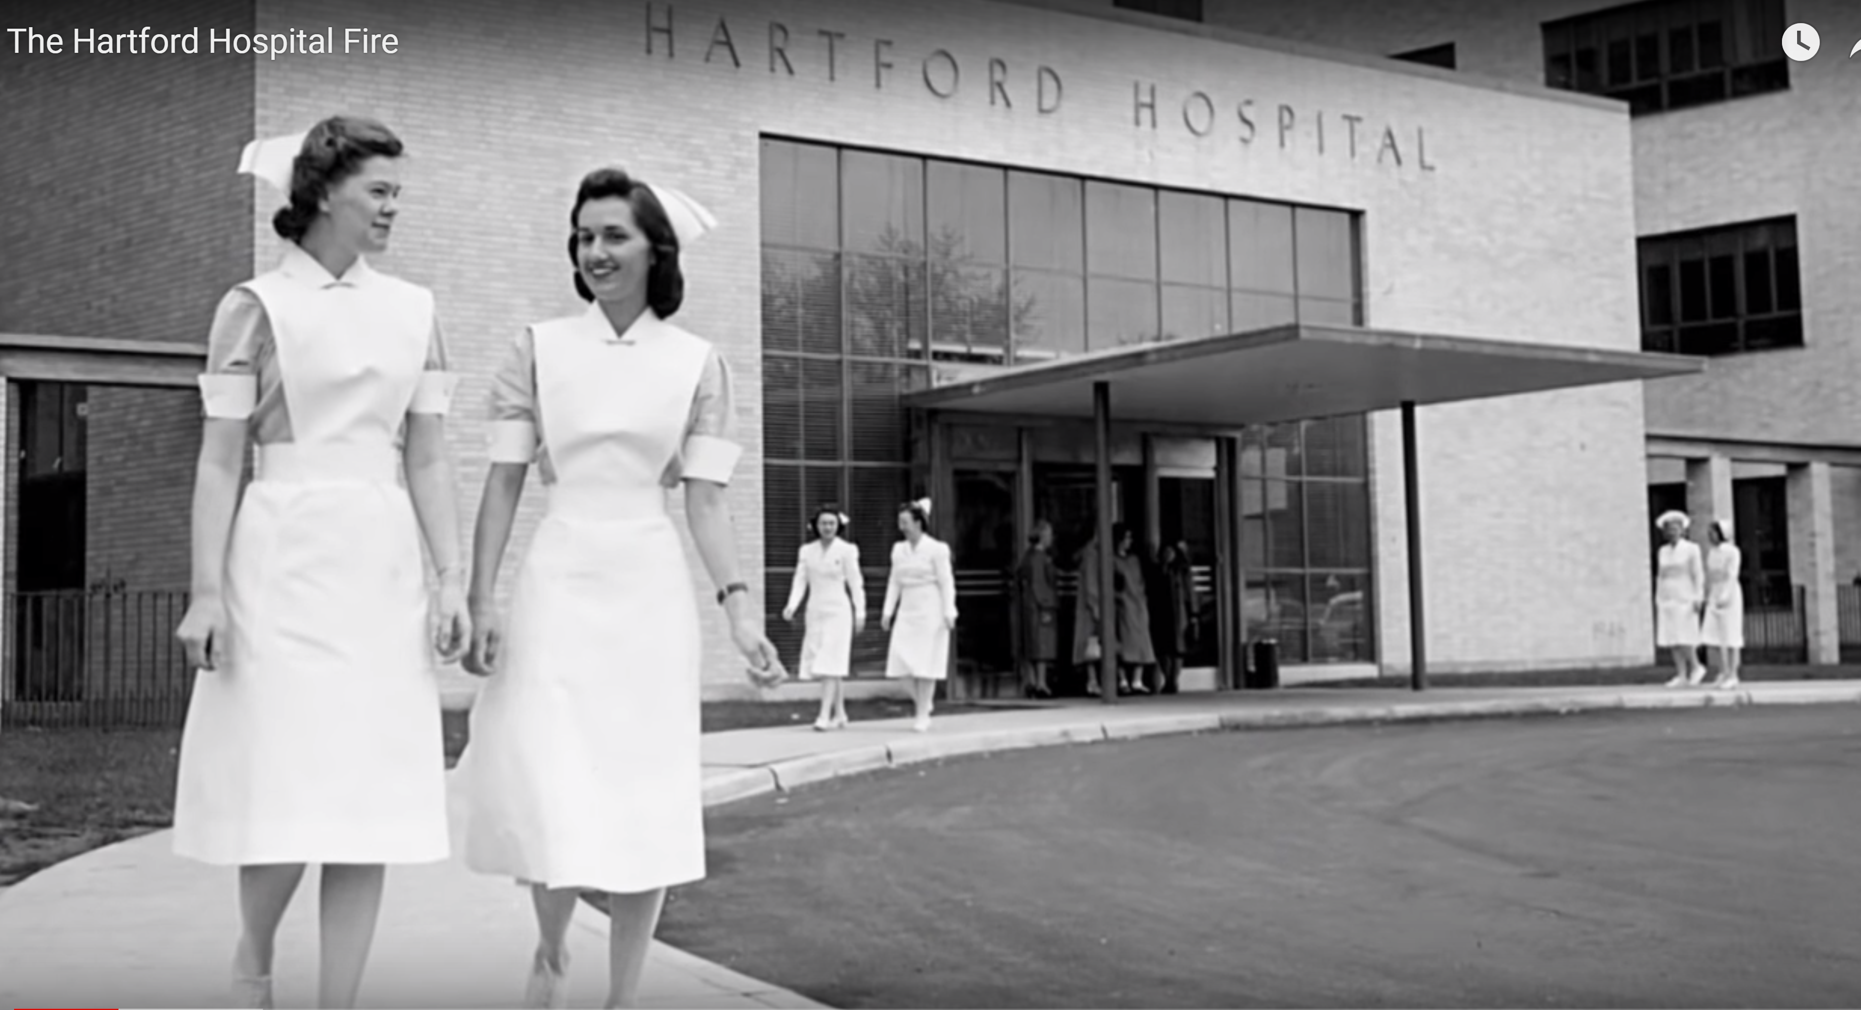
Hartford Hospital Fire – 1961

Slide 6

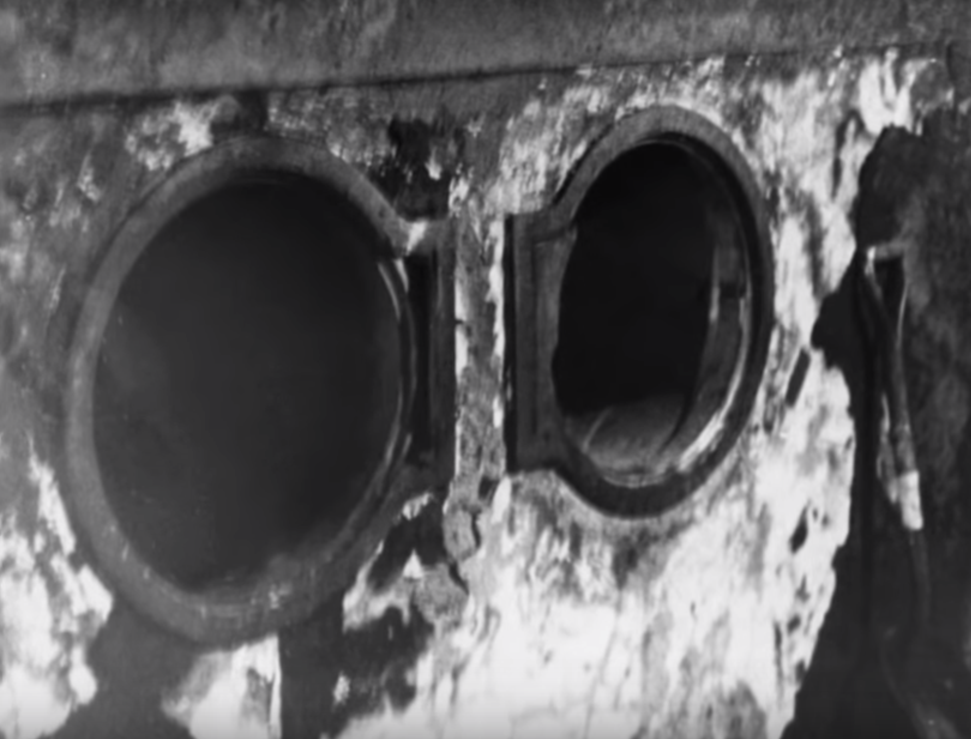
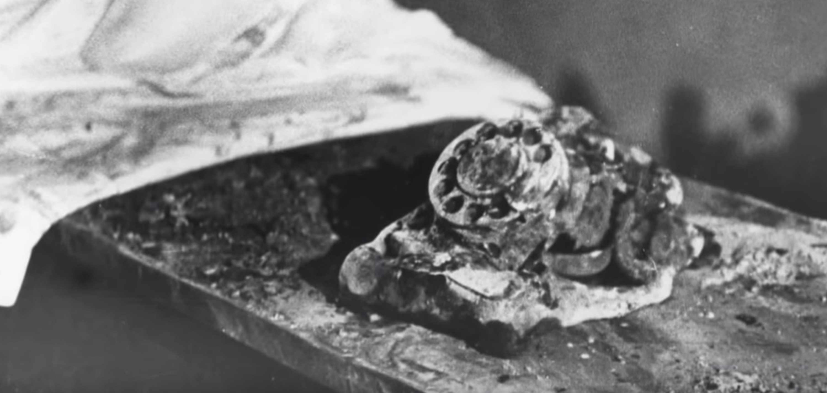
Hartford Hospital Fire – 1961

Slide 7
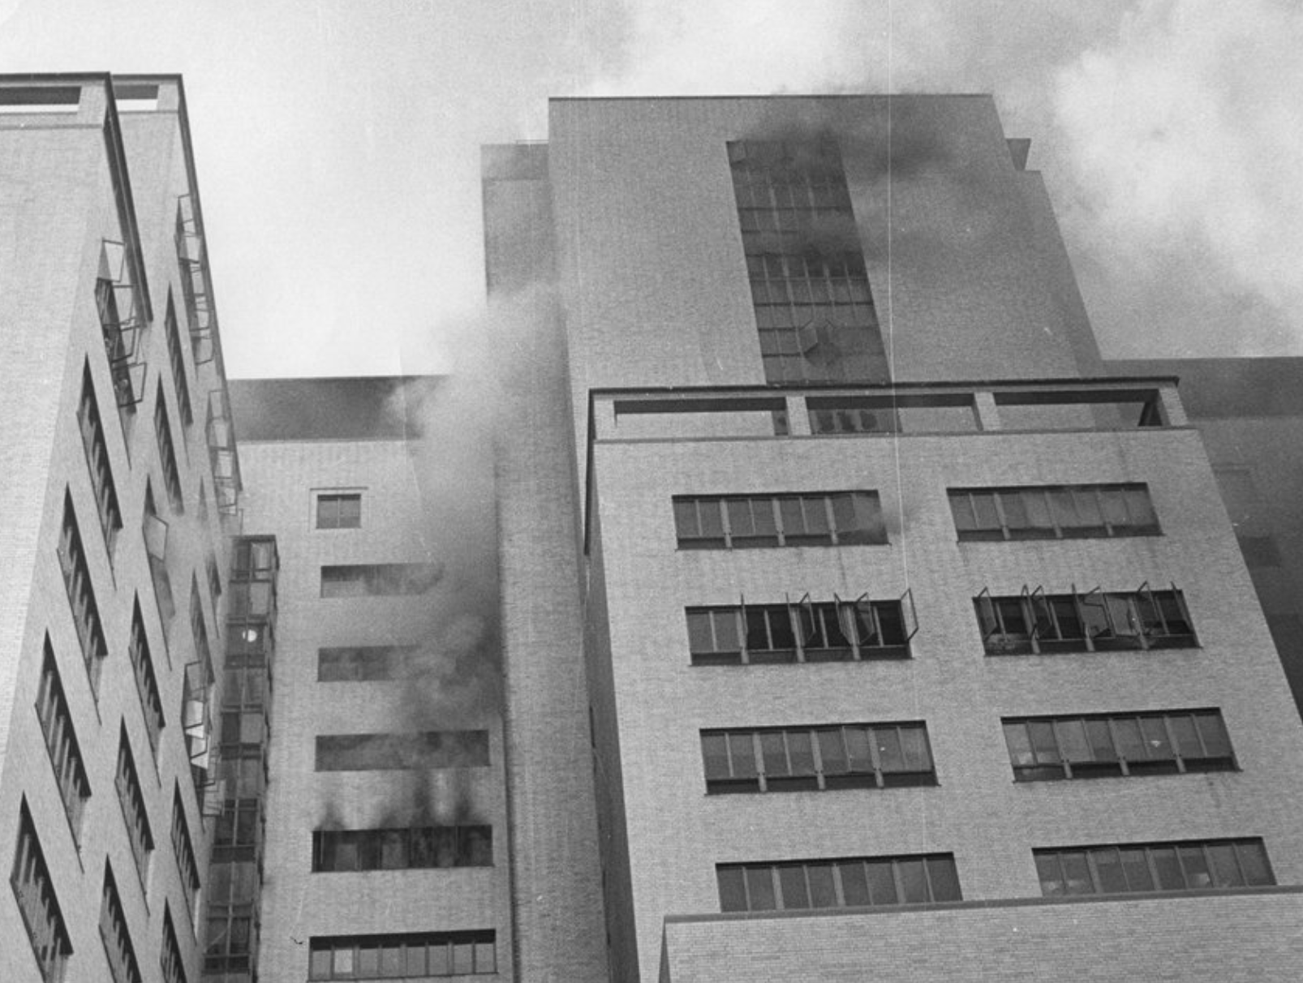
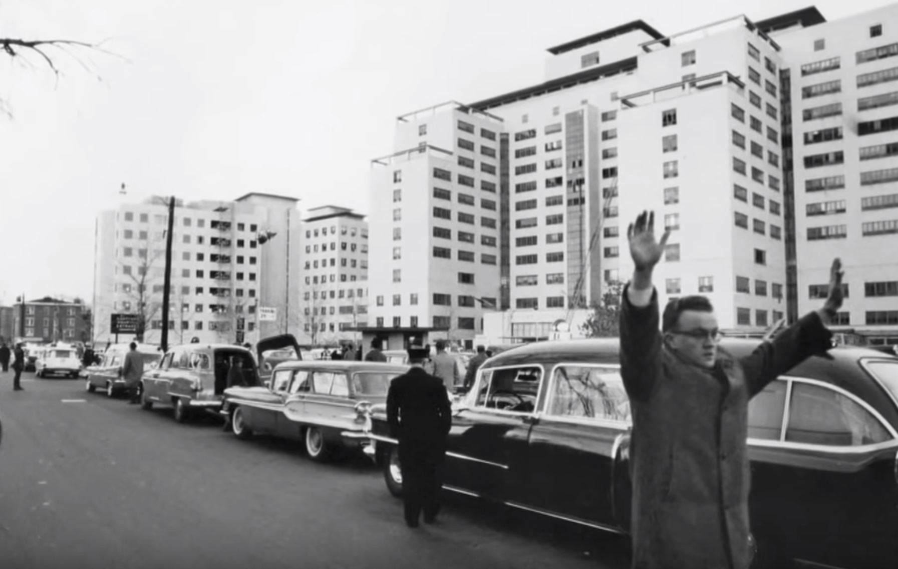
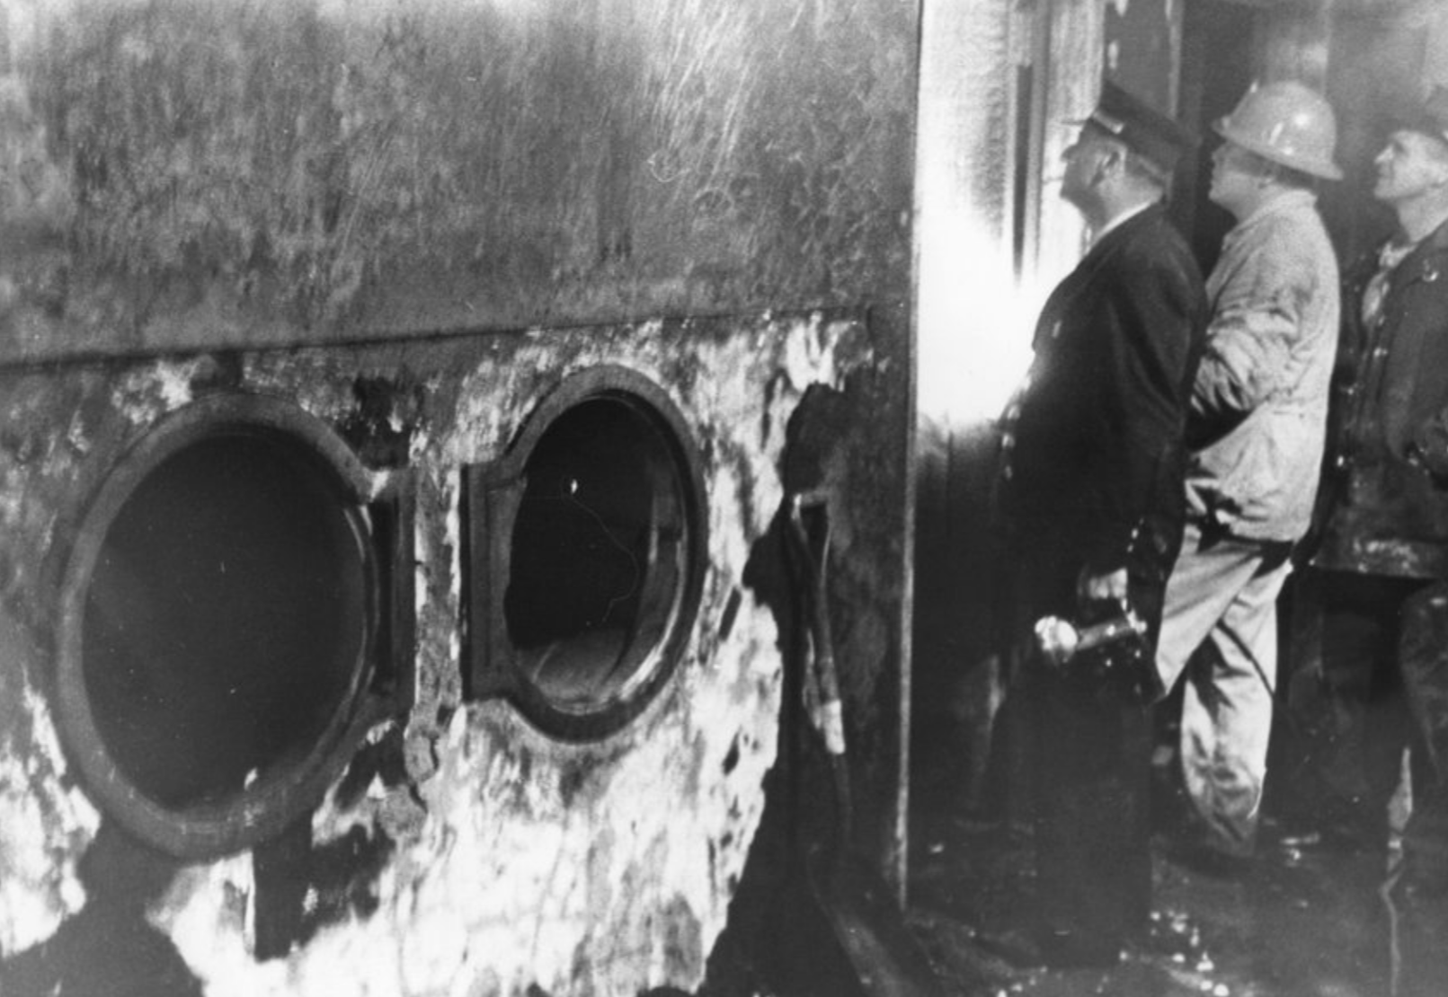
Hartford Hospital Fire – 1961

Slide 8
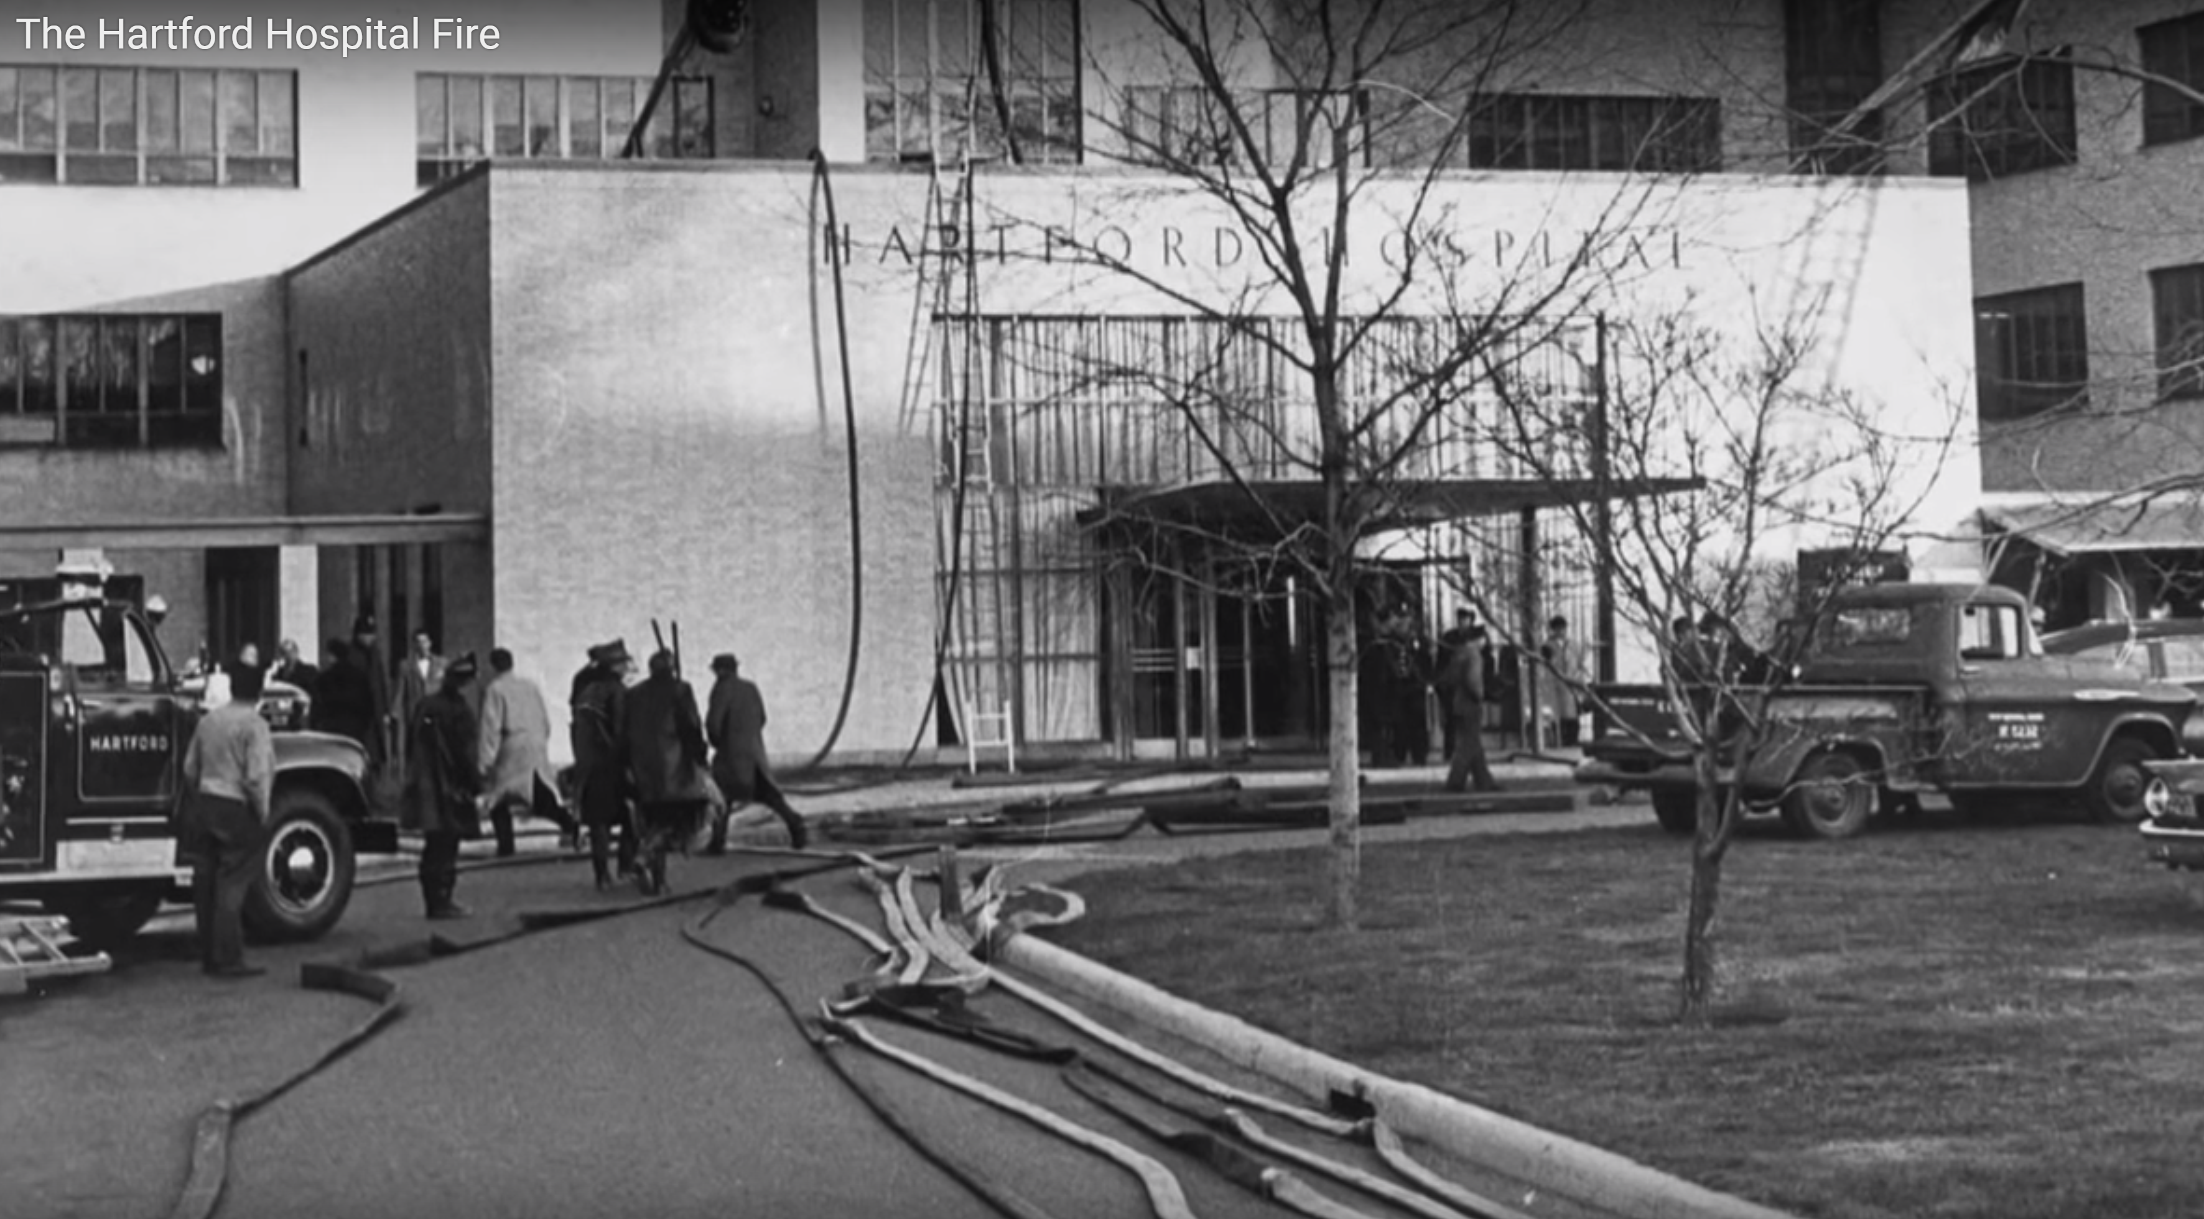
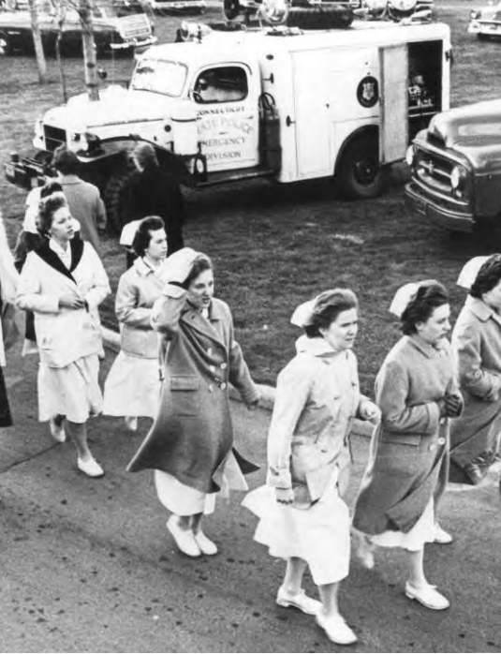
Hartford Hospital Fire – 1961

Slide 9
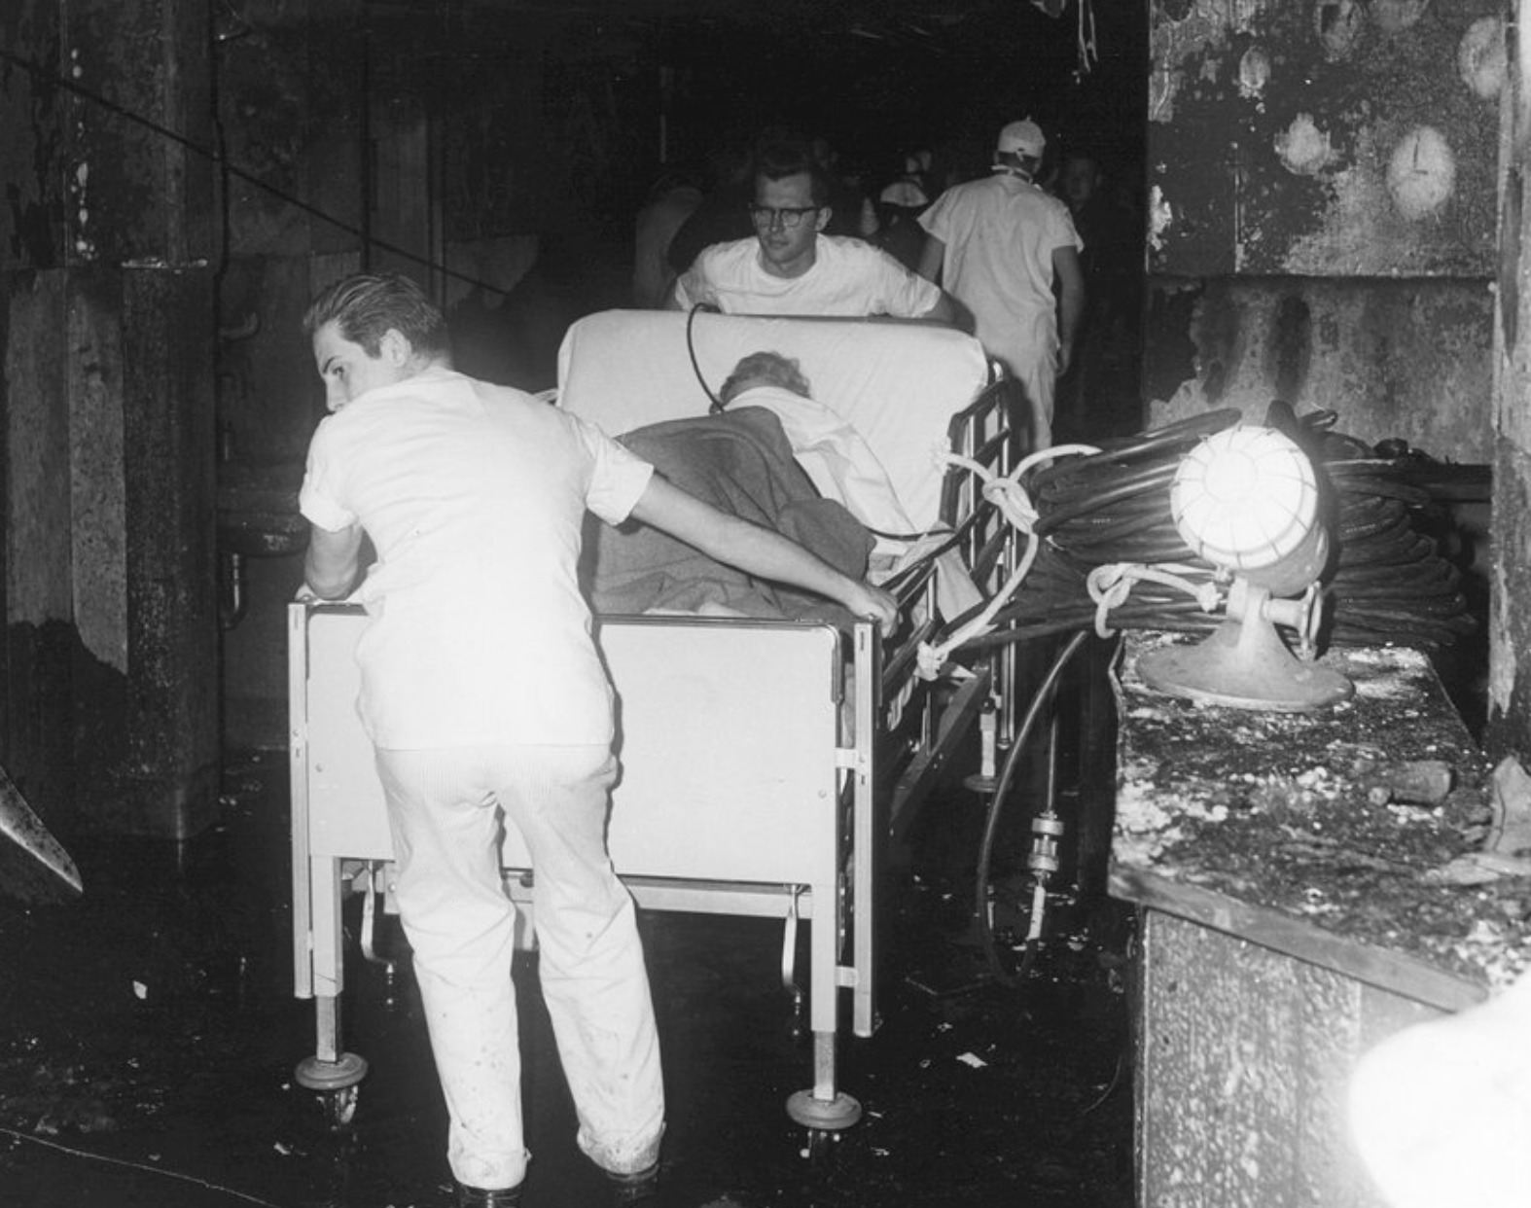
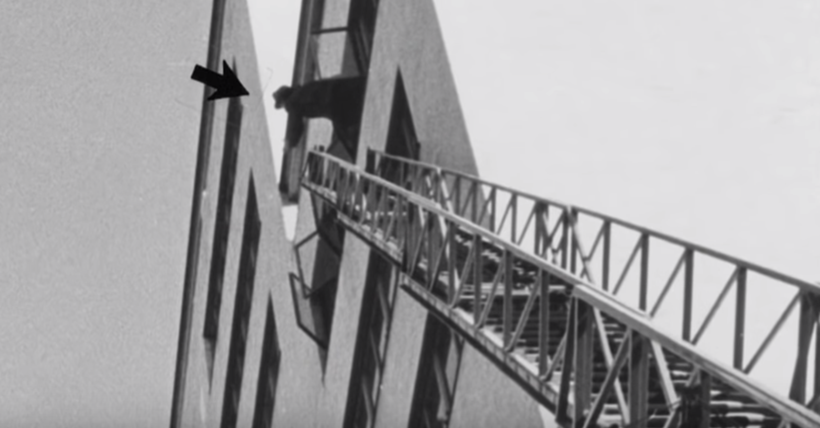
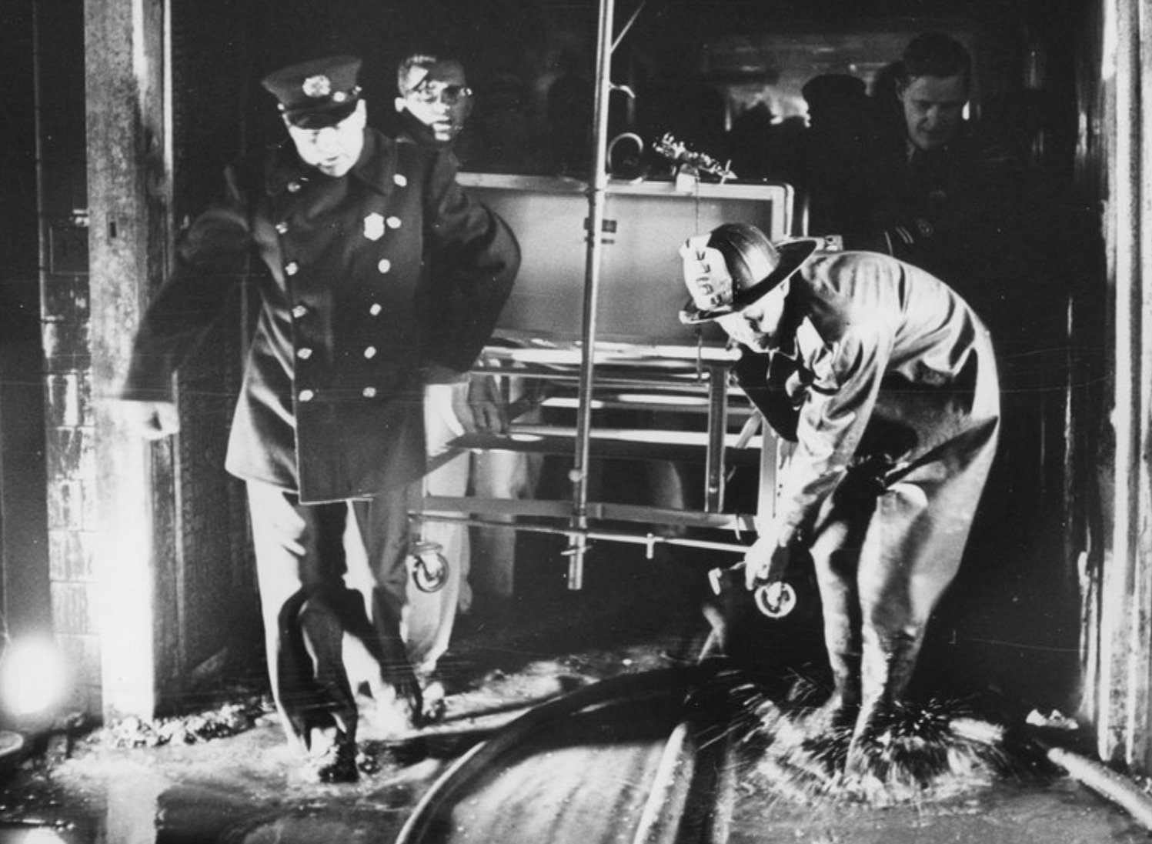
Hartford Hospital Fire – 1961 Richard Trejarian

Slide 10
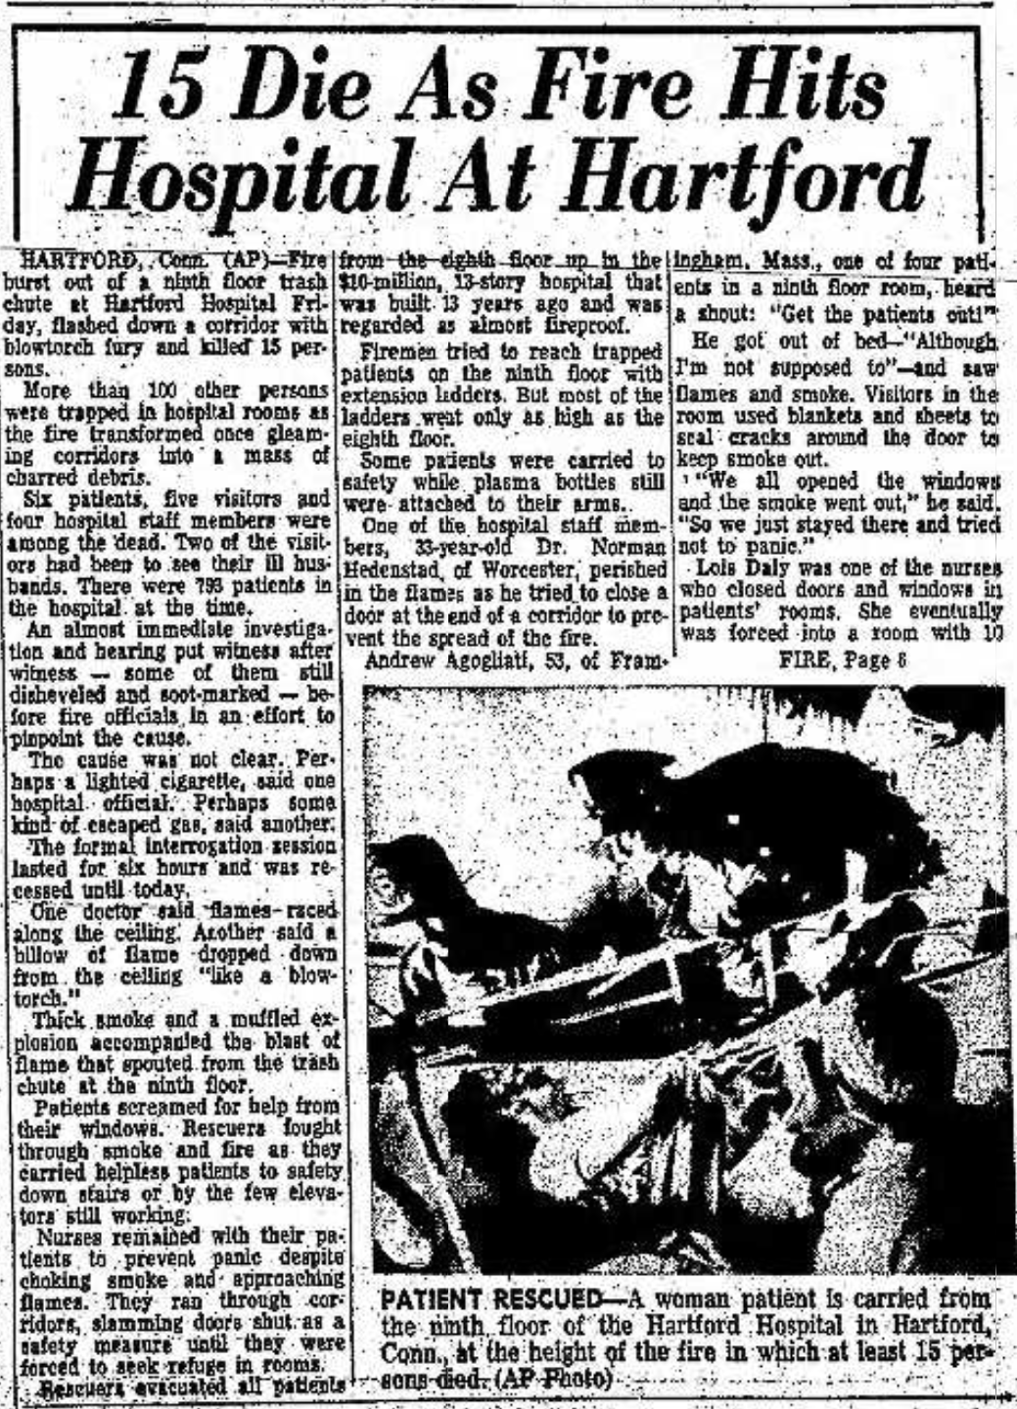
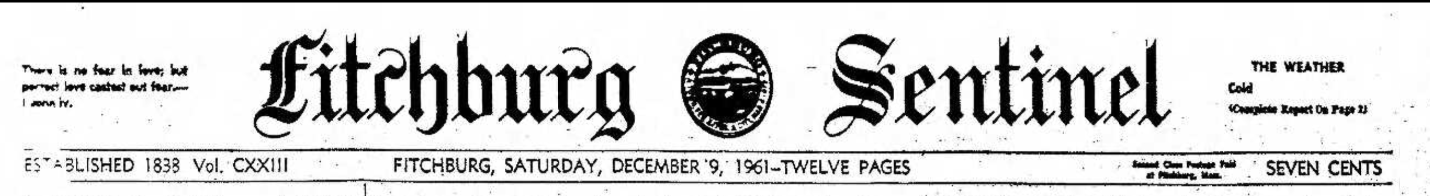
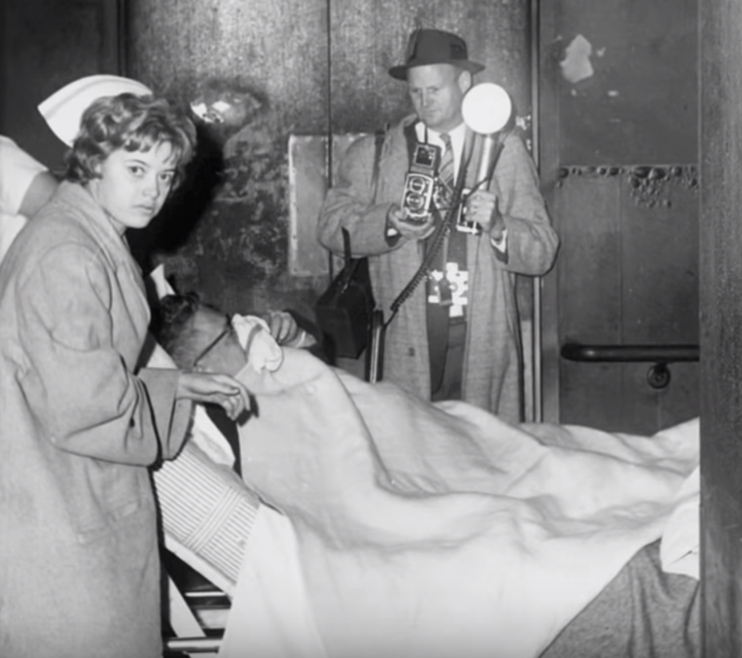
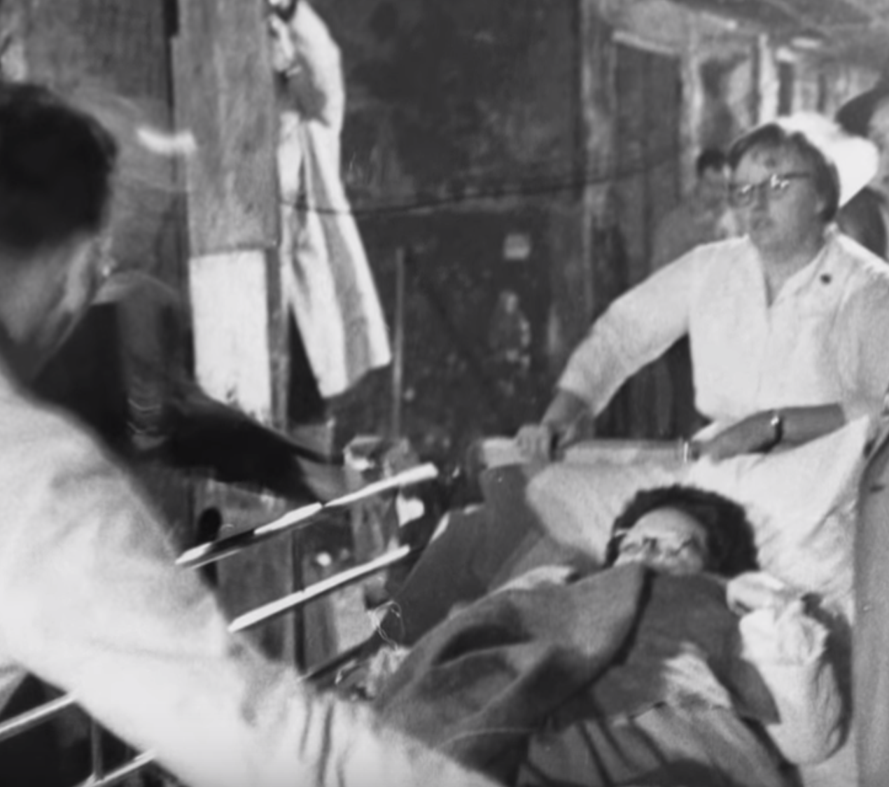
Hartford Hospital Fire – 1961

Slide 11

Hartford Hospital Fire – 1961
"We are going to investigate this, and we are going to change the way that hospitals are built.” Dr. Steward Hamilton

Slide 12
The disaster prompted changes nationwide in hospitals and building codes
Lessons Learned from the Hartford Fire:
Doors, and hardware play a critical role achieving and maintaining Life Safety. In the Hartford fire, those who stayed in rooms with closed doors survived the fire.
Any Hallways greater than 20 feet must have an exit door. This is to recognize the importance of the appropriate number of exits in the means of egress. In Hartford, people were trapped in the south wing with no way out.
Hospital must have automatic sprinklers protection. In Hartford only the hazardous areas and storages had sprinkler systems.
Fire compartmentalization has been further developed with more efficient wall separation.
Re-evaluation of the cross-corridor door in smoke compartments. Current code standards require double egress. In the 1961, it was one big 8-foot door with no opportunity to egress once closed.
All patient doors must have positive latching

Slide 13

Code Reference Material
Codes that we will reference in this presentation include:
North Carolina State Building Code (NCSBC) 2018
North Carolina State Building Code Fire Prevention Code, 2018, NFPA 101, 2015 Life Safety Code, and other codes and standards
National Fire Protection Association (NFPA) 80, Standard for Fire Doors and Other Opening Protectives
NFPA 105, Standard for the Installation of Smoke Door Assemblies and Other Opening Protectives
UL 1784 Standard for Air Leakage Test of Door Assemblies and other Opening Protectives
Photo credit: ANSI Blog

Slide 14
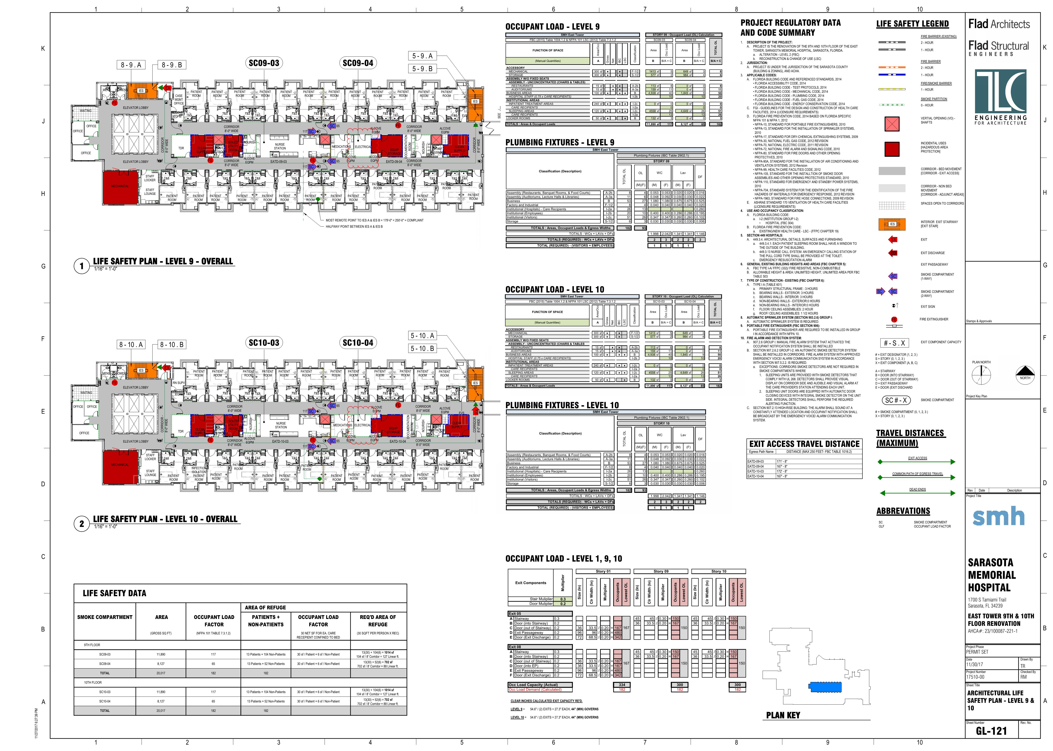
Life Safety Plans

Slide 15
Life Safety Plans
Fire/smoke compartments
Occupant load and exit width
Means of egress
Exit signage
Sprinklered areas
Fire extinguisher locations

Slide 16
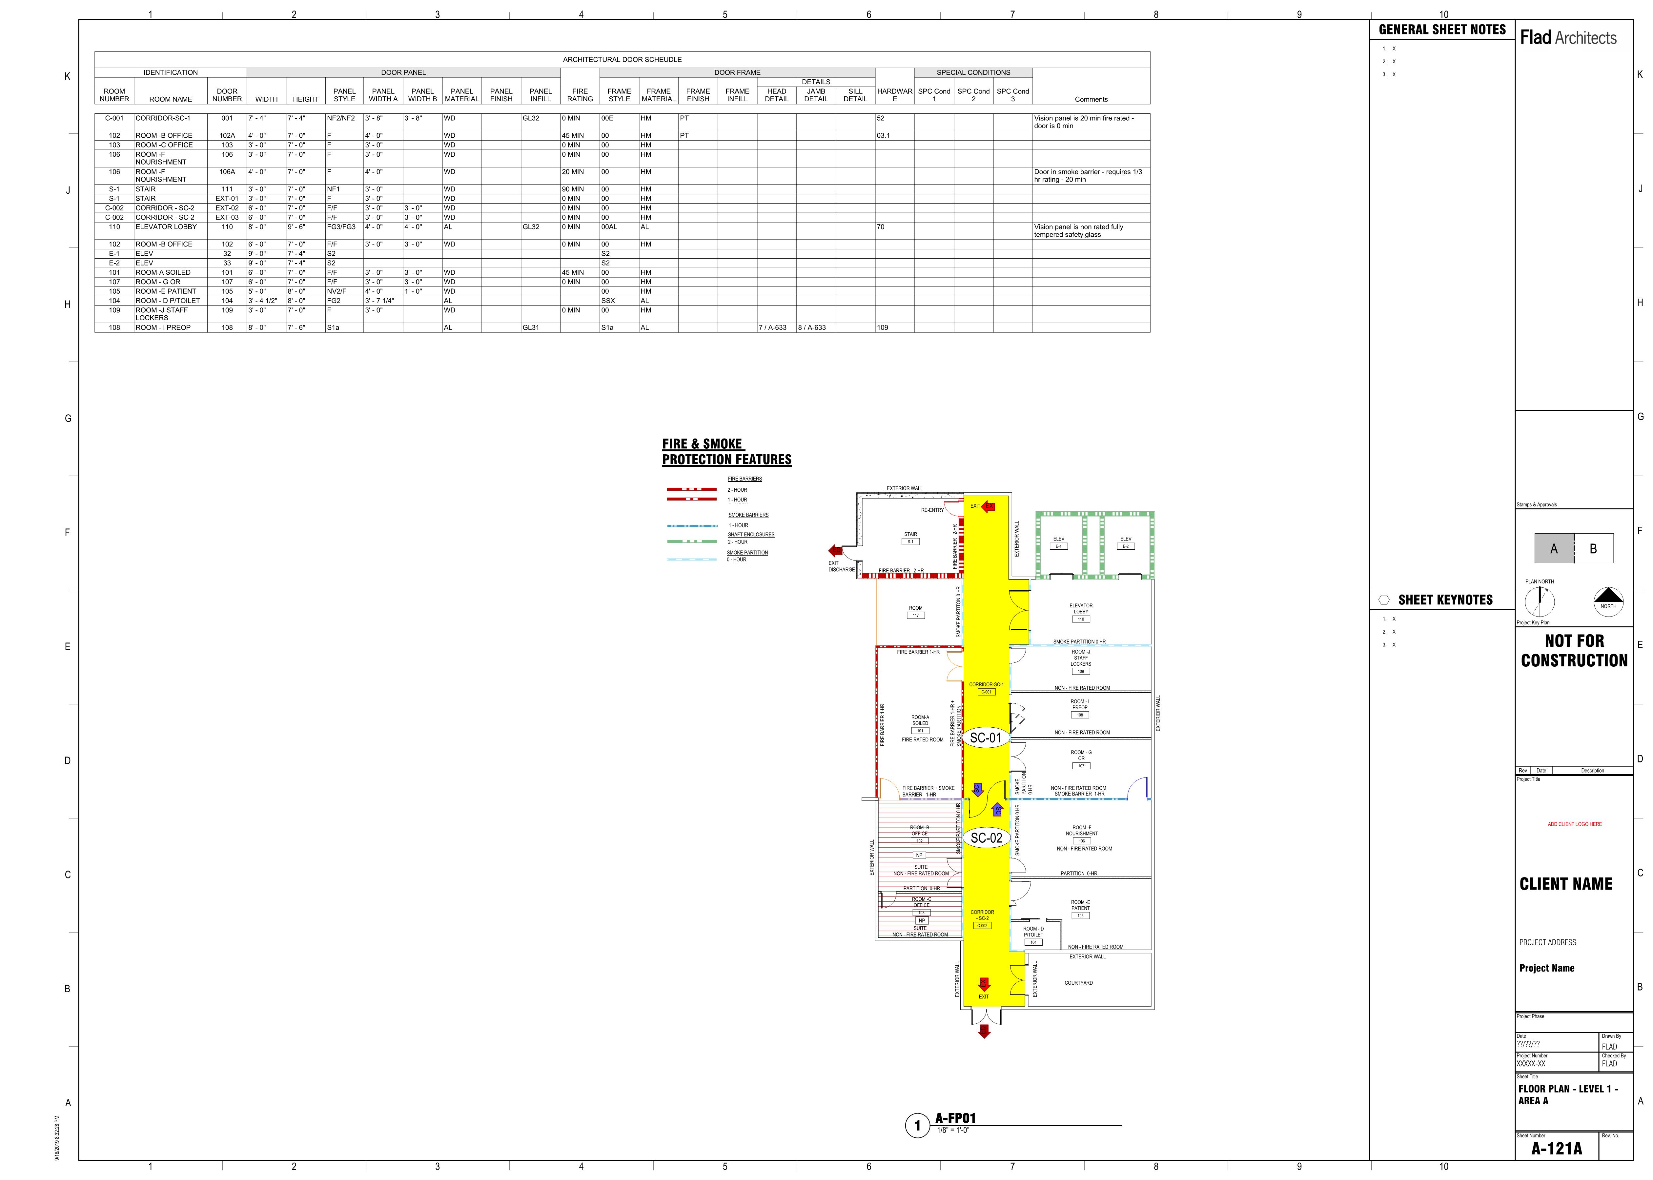
Life Safety Plans – Diagram
FIRE & SMOKE PROTECTION FEATURES

Slide 17
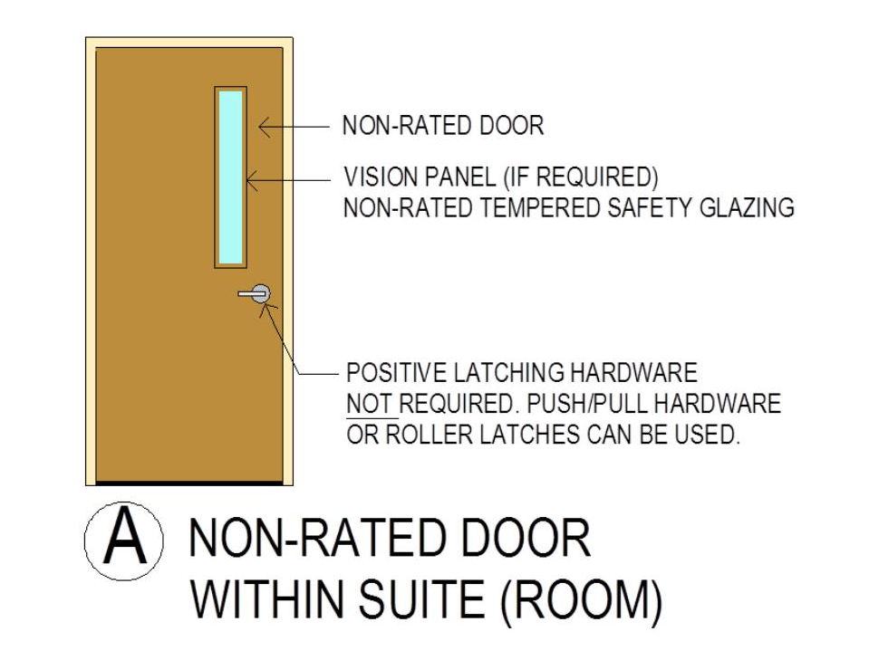
Door Hierarchy – Non-Rated Door within Suite (Room)
FIRE & SMOKE PROTECTION FEATURES
A
NON-RATED DOOR
WITHIN SUITE (ROOM)
A

Slide 18
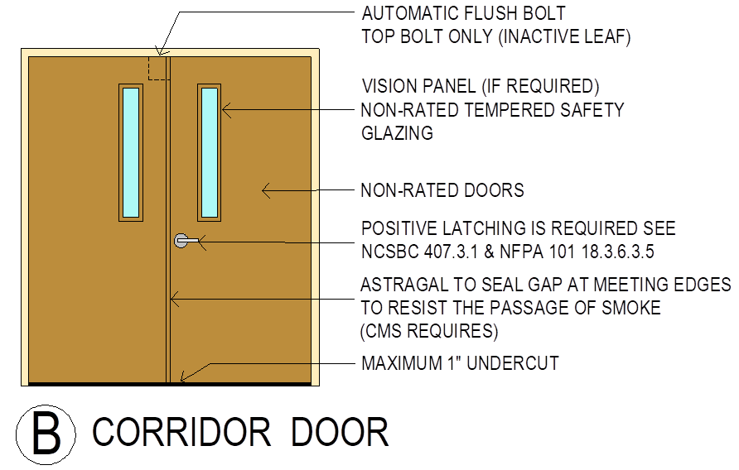
FIRE & SMOKE PROTECTION FEATURES
B
CORRIDOR DOOR
B
Door Hierarchy – Corridor Door, 0 HR. Smoke Partition

Slide 19
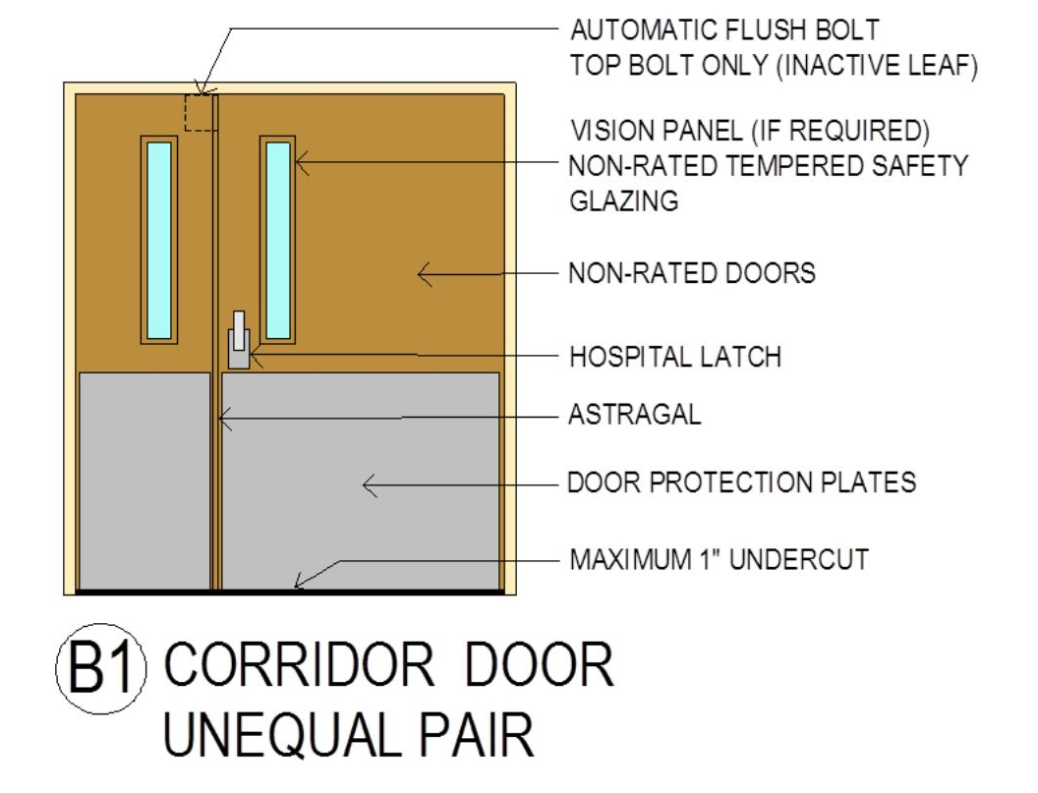
FIRE & SMOKE PROTECTION FEATURES
B1
CORRIDOR DOOR UNEQUAL PAIR
B1
Door Hierarchy – Corridor Door, 0 HR. Smoke Partition

Slide 20
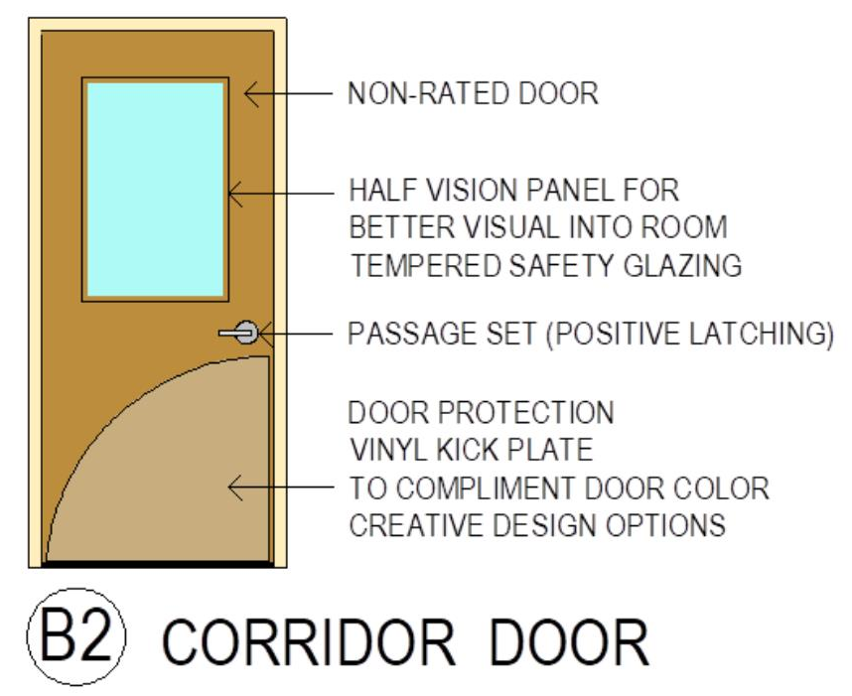
FIRE & SMOKE PROTECTION FEATURES
B2
CORRIDOR DOOR
B2
Door Hierarchy – Corridor Door, 0 HR. Smoke Partition

Slide 21
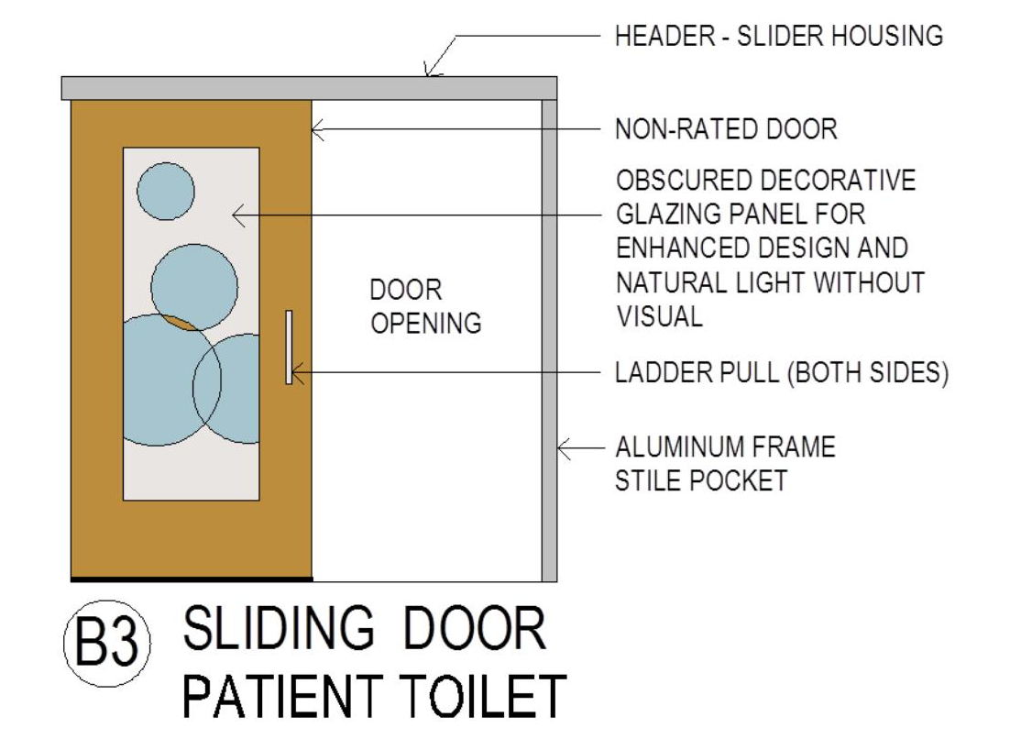
FIRE & SMOKE PROTECTION FEATURES
B3
SLIDING DOOR
PATIENT TOILET
B3
Door Hierarchy – Patient Toilet Door, Non-rated Partition

Slide 22
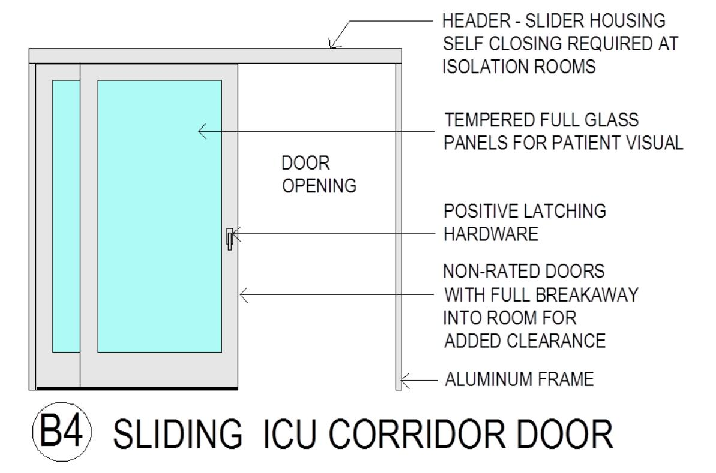
B4
FIRE & SMOKE PROTECTION FEATURES
B4
SLIDING ICU CORRIDOR DOOR
Door Hierarchy – Corridor Door, 0 Hr. Smoke Partition

Slide 23
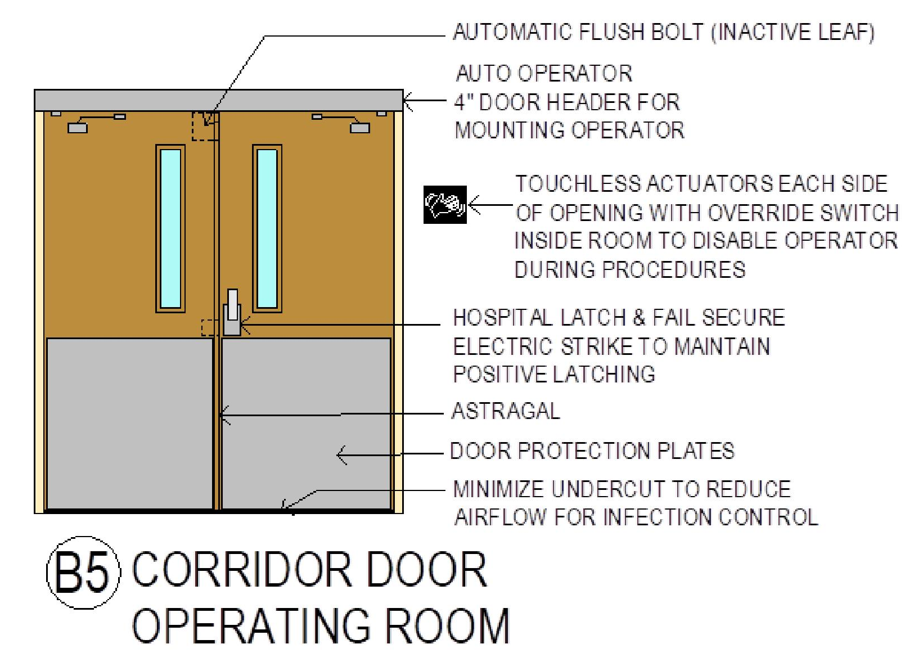
B5
FIRE & SMOKE PROTECTION FEATURES
B5
CORRIDOR DOOR
OPERATING ROOM
Door Hierarchy – Corridor Door, 0 Hr. Smoke Partition

Slide 24
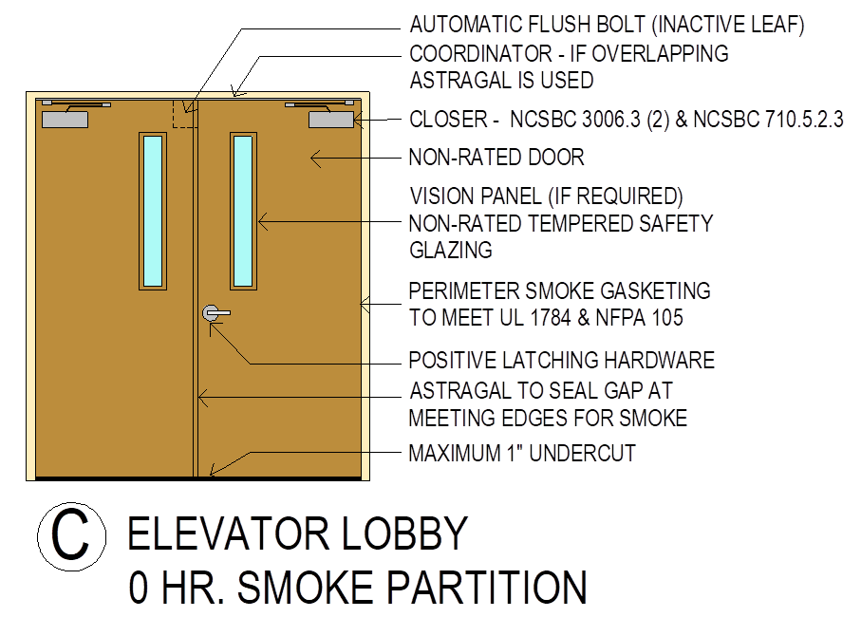
C
FIRE & SMOKE PROTECTION FEATURES
C
ELEVATOR LOBBY
0 HR. SMOKE PARTITION
Door Hierarchy – Corridor Door, 0 Hr. Smoke Partition

Slide 25
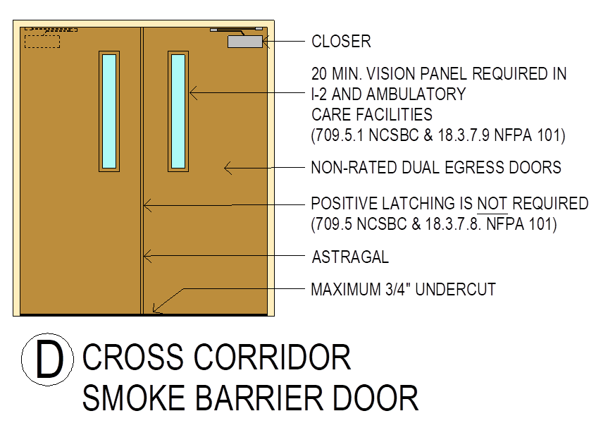
D
FIRE & SMOKE PROTECTION FEATURES
D
CROSS CORRIDOR
SMOKE BARRIER DOOR
(SMOKE COMPARTMENT)
Door Hierarchy – Cross Corridor, 1 Hr. Smoke Barrier

Slide 26
E
FIRE & SMOKE PROTECTION FEATURES
E
20 MIN. FIRE DOOR
IN SMOKE BARRIER
(SMOKE COMPARTMENT)
Door Hierarchy – ⅓ Hr. Fire Doors, 1 Hr. Fire Barrier

Slide 27
F
FIRE & SMOKE PROTECTION FEATURES
F
90 MIN. FIRE DOOR
AT STAIRWELL
Door Hierarchy – 1½ Hr. Fire Doors, 2 Hr. Fire Barrier (Exit)

Slide 28
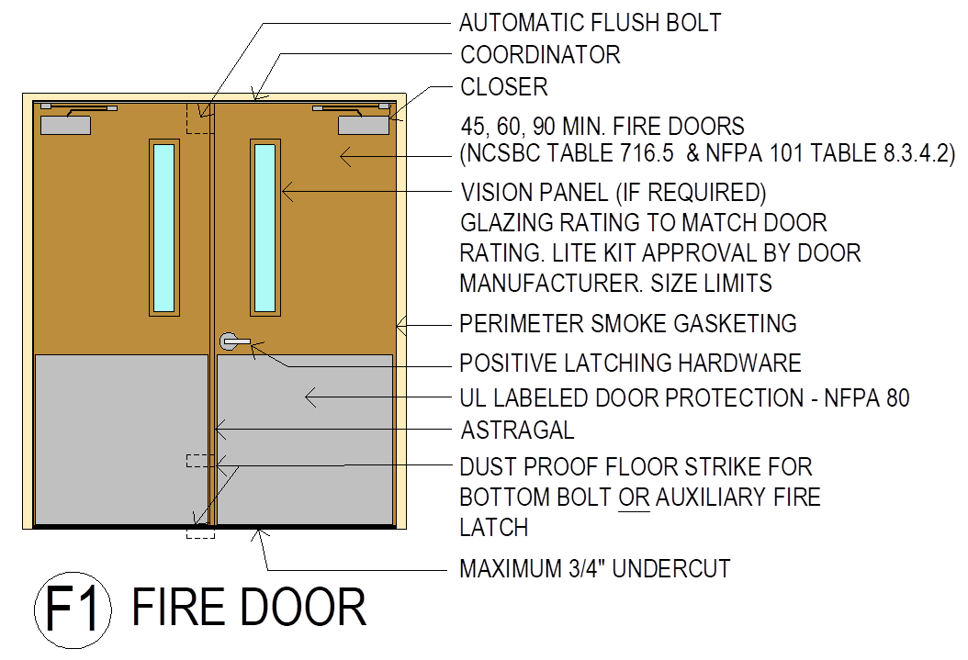
F1
FIRE & SMOKE PROTECTION FEATURES
F1
FIRE DOOR
Door Hierarchy – Fire Doors in a 1 Hr. Fire Barrier

Slide 29
F2
FIRE & SMOKE PROTECTION FEATURES
F2
45 MIN. FIRE DOOR
IN SMOKE BARRIER
Door Hierarchy – 45 Min. Fire Door in Smoke Barrier

Slide 30
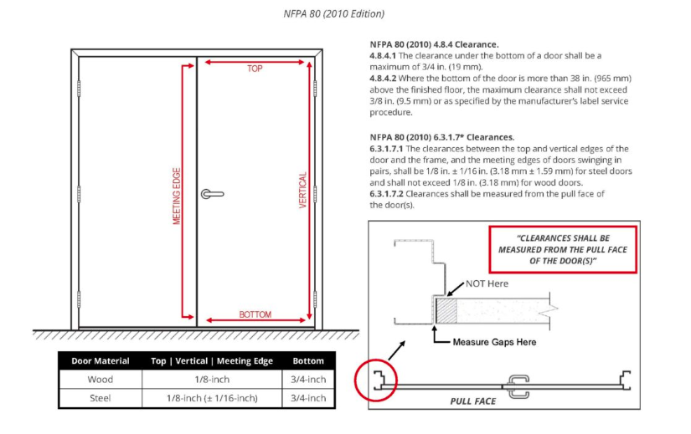
NFPA 80 – Requirements
NFPA 80 (2010) 4.8.4 Clearance
4.8.4.1 The clearance under the bottom of a door shall be a maximum of ¾ in. (19 mm).
4.8.4.2 Where the bottom of the door is more than 38 in. (965 mm) above the finished door, the maximum clearance shall not exceed 3/8 in. (9.5 mm) or as specified by the manufacturer’s label service procedure.
NFPA 80 (2010) 6.3.1.7* Clearances
6.3.1.7.1 The clearances between the top and vertical edges of the door and the frame, and the meeting edges of doors swinging in pairs, shall be 1/8 in. ±1/16 in. (3.18 mm ±1.59 mm) for steel doors and shall not exceed 1/8 in. (3.18 mm) for wood doors
6.3.1.7.2 Clearances shall be measured from the pull face of the door(s).
Door Material | Top / Vertical / Meeting Edge | Bottom
Wood | 1/8 inch | 3/4 inch
Steel | 1/8 inch (± 1/16 inch) | 3/4 inch

Slide 31
Top Reasons for LS.02.01.10 and LS.02.01.30 Door Failures
Latch failure
Rating/label
Closer missing
Gap/undercut
Hardware
Blocked
Damaged
Jerry-rigged
Door missing
Louver
Roller latch
860
343
342
336
304
137
112
49
12
11
8
100
200
300
400
500
600
700
800
Joint Commission findings related to fire-door maintenance. Graphic courtesy of the American Society for Health Care Engineering.
Door Inspection and Maintenance

Slide 32
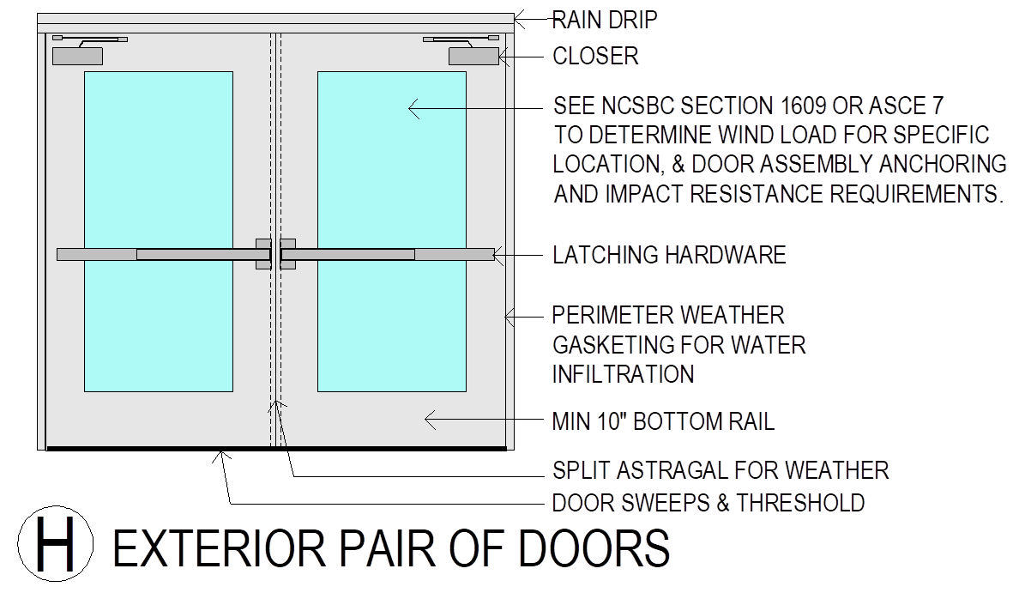
FIRE & SMOKE PROTECTION FEATURES
H
EXTERIOR PAIR OF DOORS
Door Hierarchy – Exterior Doors
H

Slide 33
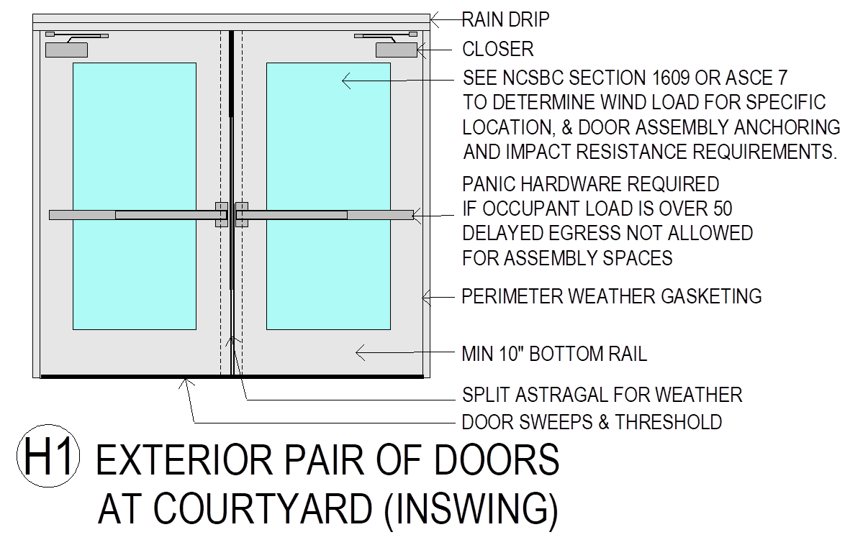
FIRE & SMOKE PROTECTION FEATURES
H1
EXTERIOR PAIR OF DOORS
AT COURTYARD (INSWING)
H1
Interior Courtyards – Exterior Doors, Means of Egress

Slide 34
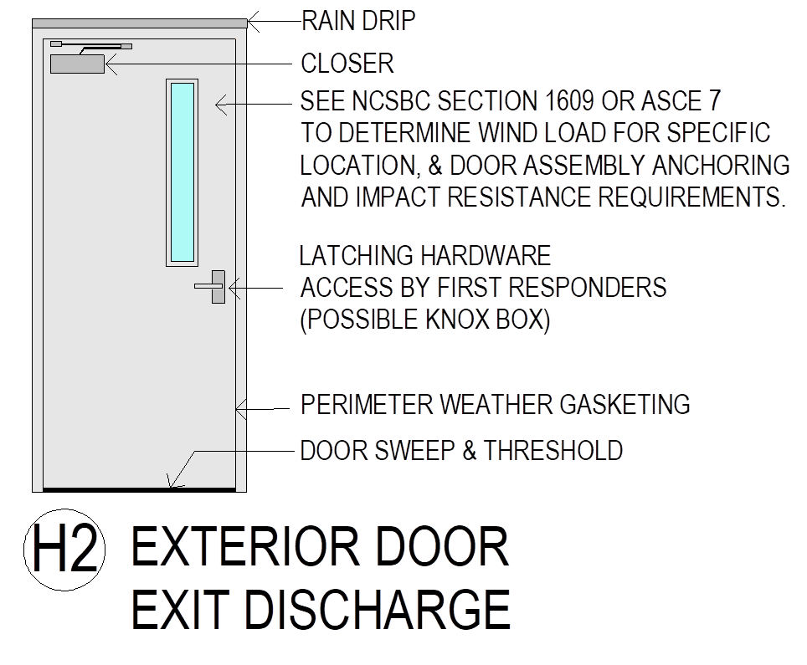
H2
FIRE & SMOKE PROTECTION FEATURES
H2
EXTERIOR DOOR
EXIT DISCHARGE
Door Hierarchy – Exterior Door, Exit Discharge

Slide 35
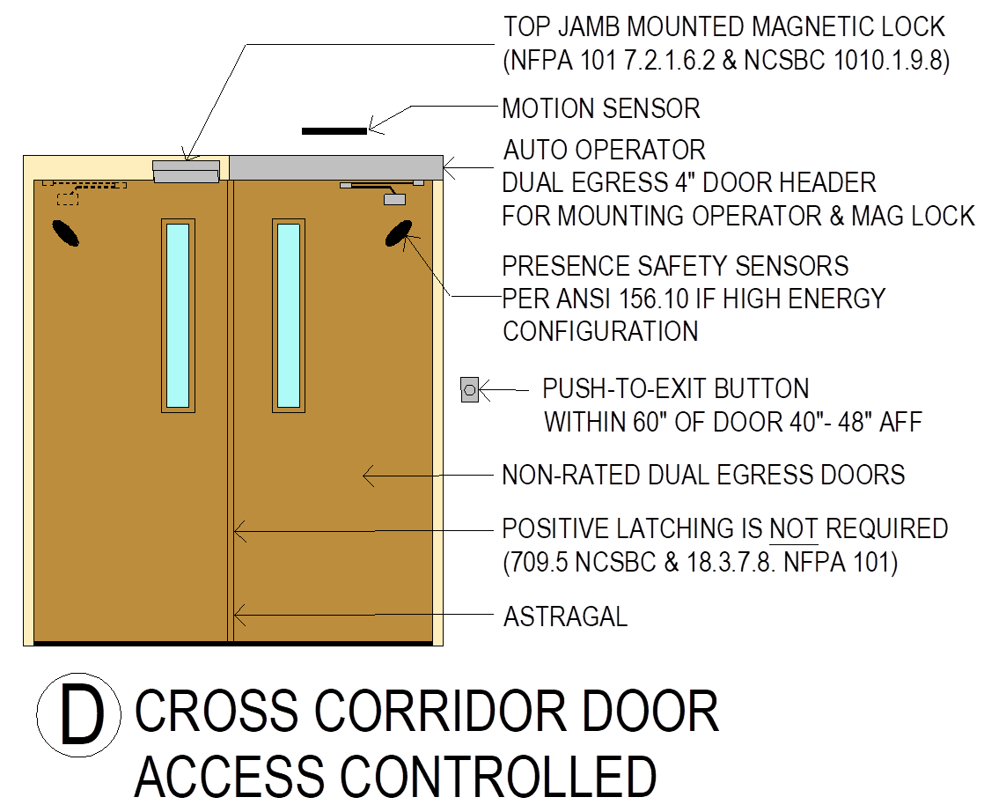
D
FIRE & SMOKE PROTECTION FEATURES
D
CROSS CORRIDOR DOOR
ACCESS CONTROLLED
Door Technology – Cross Corridor Door, Access Controlled

Slide 36
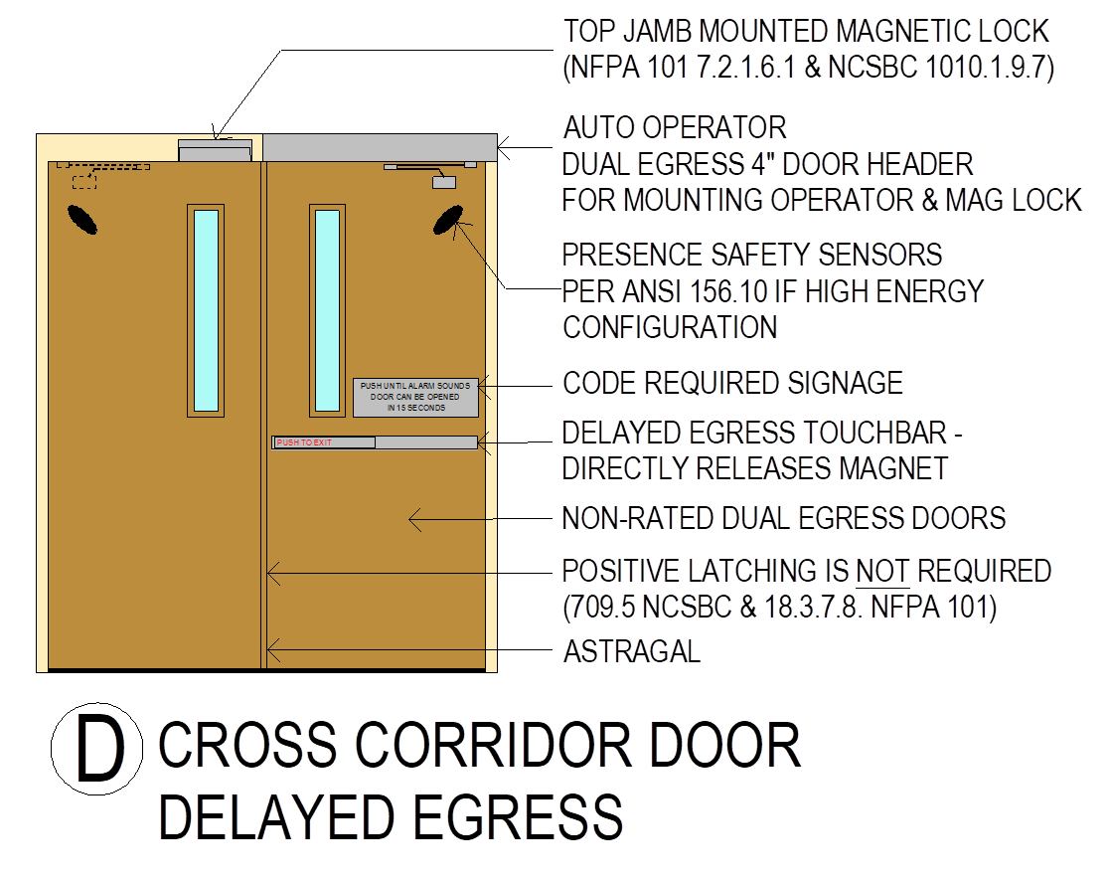
D
FIRE & SMOKE PROTECTION FEATURES
D
CROSS CORRIDOR DOOR
DELAYED EGRESS
Door Technology – Cross Corridor Door, Delayed Egress

Slide 37
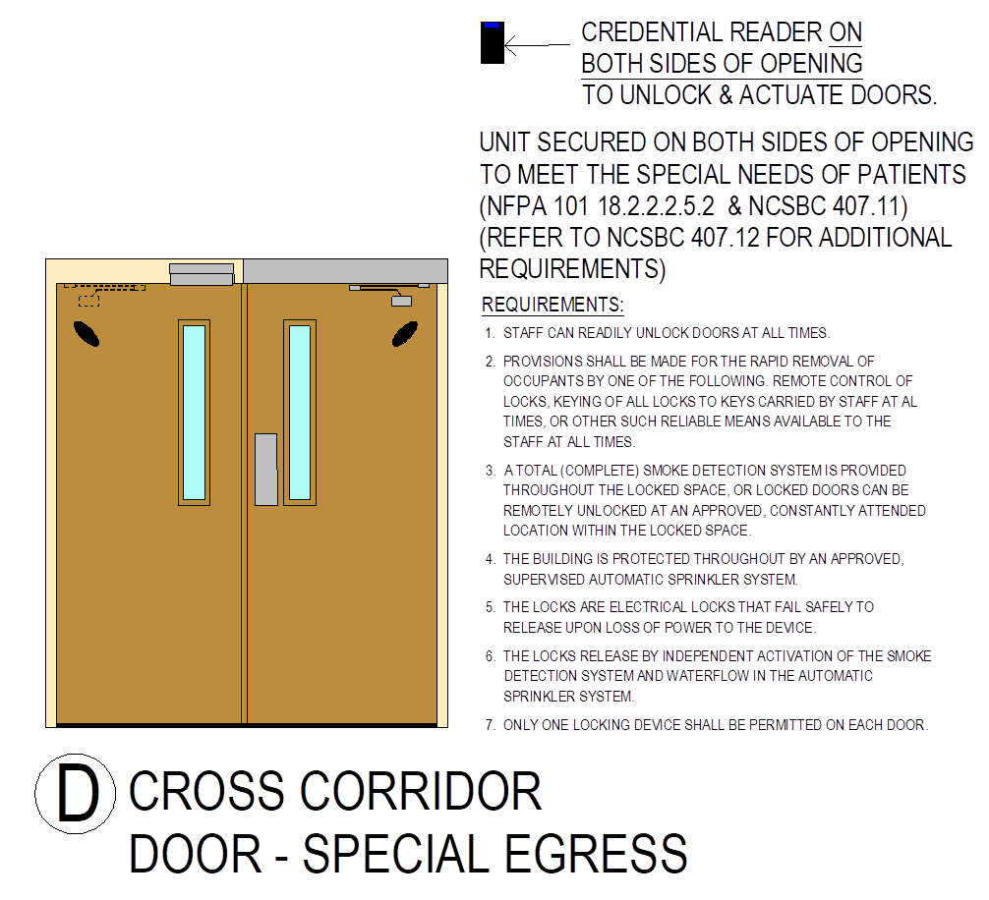
D
FIRE & SMOKE PROTECTION FEATURES
D
CROSS CORRIDOR DOOR
SPECIAL EGRESS
Door Technology – Cross Corridor Door, Special Egress

Slide 38
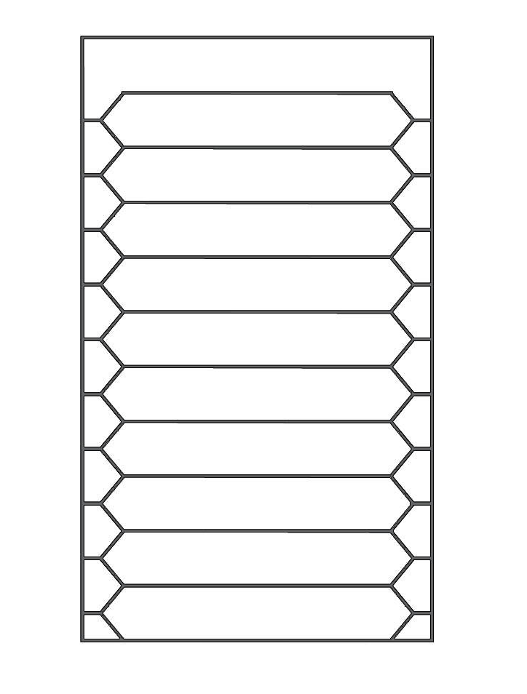
Re-Entry from Stairwell
Stairwell Re-entry
2012 NFPA 101
Stairs serving 4 stories or less can be mechanically locked from the stair side.
Locked stair doors must be automatically released upon activation of the fire alarm system.
NCSBC 2018
403.5.3 Doors locked on the stair side must be capable of being simultaneously unlocked without unlatching from the fire command center or a signal by emergency personnel from a single location inside the main entrance to the building.
403.5.3.1 High-Rise buildings require two–way communication system
Specify fail-safe electrified locks to ensure doors (where required) will be unlocked in the event of power loss.
11
10
RE-ENTRY POINT
9
8
7
6
5
RE-ENTRY POINT
4
3
2
1
RE-ENTRY POINT

Slide 39
Hartford Hospital Fire – 1961
"We are going to investigate this, and we are going to change the way that hospitals are built.” Dr. Steward Hamilton

Slide 40
In memory of
Nancy Coniglione, patient
Henrietta Conover, visitor
Jennie Dunn, patient
Adelene Fainter, visitor
C. Frederick Greenleaf, patient
Laura Greenleaf, visitor
Grace Hatch, employee
Dr. Norman Hedenstad, resident physician
Gladys Kokaska, patient
Ruth LaPenta, patient
Theresa Mascaro, visitor
Diane Pape, patient
Angeline Seigel, visitor
Charles Seigel, patient
Sadie Ward, employee
Marion Winget, nurse

Slide 41
Hartford Hospital, Connecticut – 1961

Slide 42
Thank you!
DOORS AND HARDWARE FOR HEALTHCARE
PRESENTERS:
Greg Meyer AIA, LEED AP Architect
Flad Architects
Ramon Moll AIA, NCARB Architect
Flad Architects
march 12, 2020 | spring seminar |

