Slide 1
Improving Patient Care through Energy to Care

Slide 2
Speaker:
Daniel Bland
Corporate Energy Manager
Novant Health
debland@novanthealth.org

Slide 3
Agenda
Why Efficiency is Important
Overview of ASHE Energy to Care Program
Continuous Improvement
Notes:
Health care must strive to provide the highest quality, cost effective patient care.
In order to do this, and thrive in the current health care environment, hospitals and health systems must be diligent in reducing costs.

Slide 4
Why Efficiency is Important

Slide 5
Why is efficiency important?
Energy Costs are typically 51% of a health care facility department’s budget.
Energy cost inflation…off the bottom line!
Patients and staff take notice
Differentiate your hospital or system
Why else? Let’s hear from you!
Notes:
Inflation less than 2% while utilities escalation is closer to 4%
Cost savings (bottom line) is equivalent to 20X top line revenue
Average utility escalation between 3-5%. For every $1M of spend, energy escalation of ~$40,000 per year
EUI is a metric that is often used in comparing energy use in buildings. EUI is simply energy consumption per unit of area of the building’s floorplan. Hospital consume the 2nd most consumptive building type – second behind food services.
Ask audience why they believe sustainability/efficiency is important

Slide 6
ASHE Energy to Care Program

Slide 7
What is Energy to Care?
Energy to Care is a complimentary program to help health care facilities monitor, reduce, and communicate energy consumption.
Awards and Success Stories (Recognition)
Energy dashboard and system challenges (Tools)
Energy data remains confidential! energytocare.org
is supported by:
Notes:
Program designed with an understanding of the challenges and barriers healthcare faces:
Limited operating budget
Facilities group with no free time to learn another program
Facilities team that must proficient at a variety of tasks and skills…cannot take on another complex program

Slide 8
Why Should I Participate?
Reduce BTUs, not FTEs.
Notes:
Hammer this point home!

Slide 9
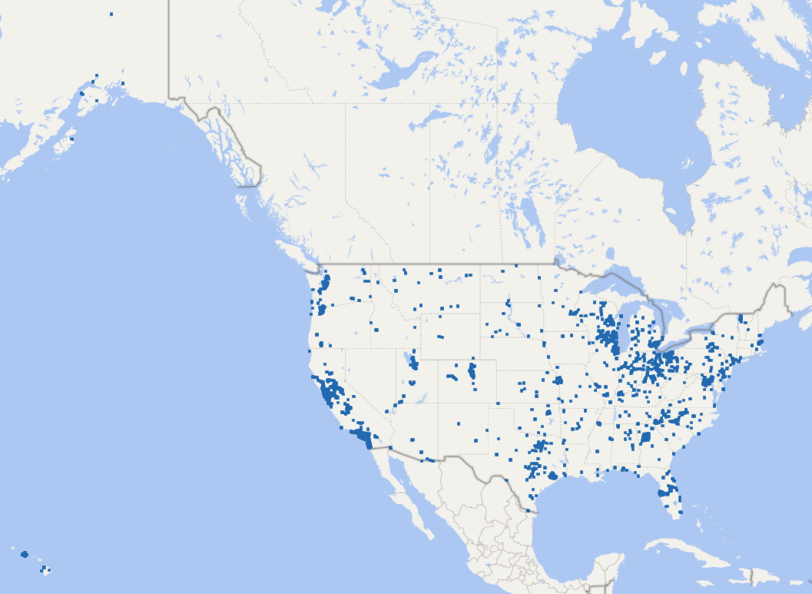
Current Energy to Care Participation
OVER 3,400 Participating Facilities
Notes:
Current participation rate for Energy to Care.

Slide 10
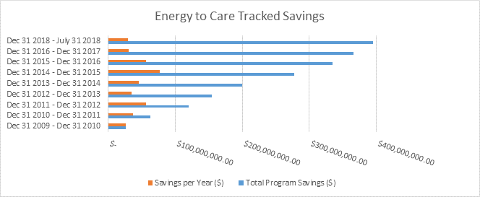
Financial - Total Program Savings
Since 2010, hospitals and health care facilities participating in ASHE's Energy to Care program have put more than $395 million dollars in energy savings back into patient care.
Notes:
The program started in 2010 and since then we have saved $395M. This has allowed members to reallocate the funds to improve patient care.

Slide 11
Energy to Care Product Line – Bringing Value
1. Dashboard Tool
2. Education
3. Treasure Hunt Program
4. Awards and Challenges
You Can’t Manage What you Don’t Measure!
Notes:
Brings us to the Energy to Care program.
The goal of Etc. is to provide resources that will help FM improve operation of a facility.
4 product lines – each leading to the next
Bench mark – lets them understand what the facility is using. We utilize Energy Star Portfolio manager and provide the participants with a free dashboard tool.
Education – provide resources to encourage action – monographs, tips of the month, success stories
Treasure Hunts – Hands on approach to promote behavior and reinforce change
Awards – recognition for efforts

Slide 12
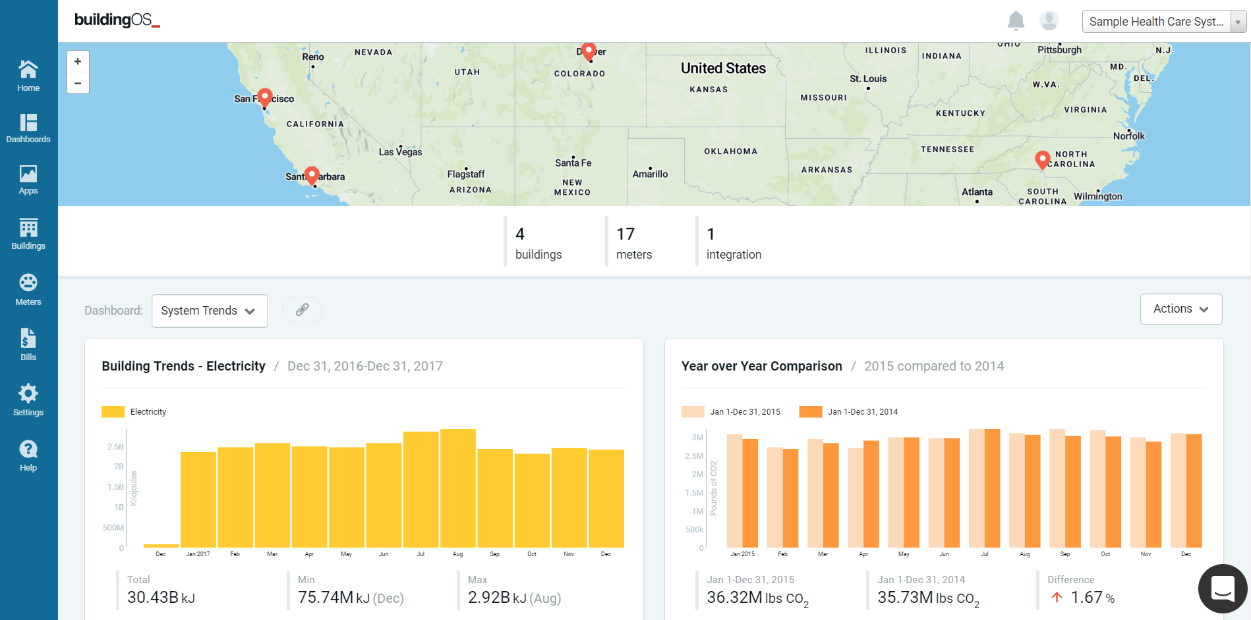
1. Energy to Care Dashboard Tool
FM inputs building and utility data in Energy Star Portfolio Manager
FM Shares Data with ASHE
FM Shares Data with Lucid Building OS
ASHE buildings free dashboard in Building OS
Special thanks to the Energy to Care Diamond Sponsor!
Notes:
Process for enrolling in Energy to Care

Slide 13
ENERGY TO CARE - CONFIDENTIALITY
Data confidentiality appears to be a common concern among hospitals considering whether to participate in Energy to Care or not.
Data will not be distributed or shared with any other entity without the express written consent of the participating healthcare system.

Slide 14
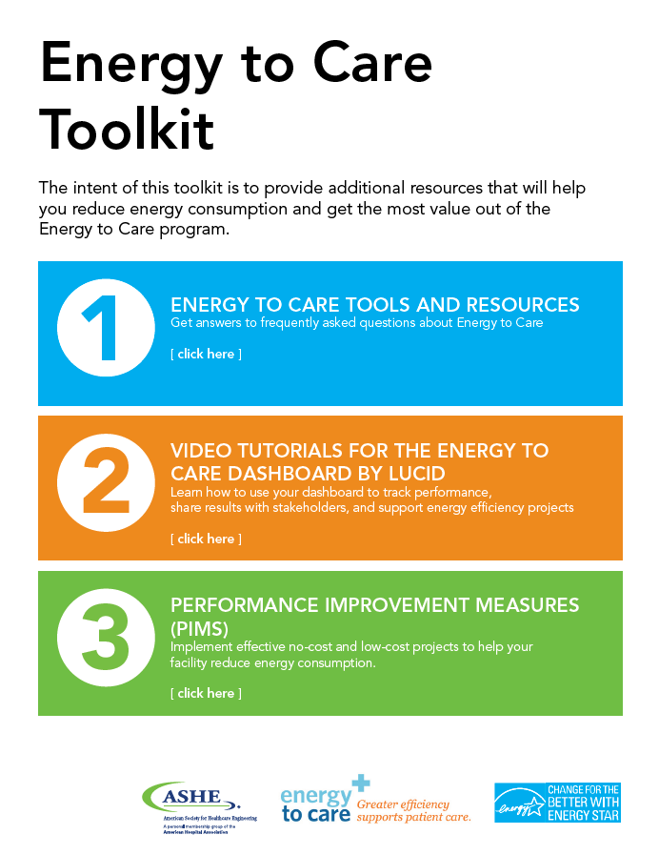
2. Energy to Care – Educational Resources
Notes:
Numerous educational resources available on the Energy to Care and ASHE websites including:
Sustainability Tip of the Month – blog style articles from industry experts on the Energy to Care website
Monographs – including recently published, “Reducing Operational costs Through Energy Efficiency” Includes energy savings project tips for low cost/no cost measures, new construction, energy procurement, renewable energy, etc. Includes case studies from a variety of facility sizes in numerous geographical regions across the US.
Energy to Care Success Stories – More Success stories on the Energy to Care website that feature a variety of facility sizes in numerous geographical regions across the US.
myASHE on-line member community to receive input from peers
Energy to Care Toolkit, including performance improvement measures with a variety of energy efficiency projects.

Slide 15
3. Energy to Care Treasure Hunt
Participants learn to identify low cost/no cost measures for efficiency as well as Capitol Measures.
Treasure Hunts result in a culture change geared toward efficiency.
Engage layers of personnel
Notes:
What is an Energy to Care Treasure Hunt?
The Energy to Care Treasure Hunt is a 1 to 3 day ASHE hosted program event based on the ENERGY STAR Treasure Hunt Program. The program is designed to engage attendees in identifying low-cost energy savings opportunities from behavioral, operational, and maintenance actions. Treasure Hunts provide training, allowing teams to focus on identifying energy efficiency improvements and to develop a philosophy of building an energy culture inside their organizations. Since its rollout, the Energy to Care Treasure Hunt has been a success in helping hospitals become more efficient, thus conserving more resources for patient care. The program has helped some hospitals identify over $200,000 in energy savings! These incredible case studies have solidified that this program is wildly effective for hospitals striving to reduce costs and inspire behavior change for building a culture of efficiency. Energy to Care Treasure Hunts can be conducted as a Chapter Event or by an individual, hospital, system or network. The hope of the program is that attendees will learn how to apply what they’ve learned on the hunt back at their own facilities, inspiring a ripple effect of culture change and resource conservation.

Slide 16
Key Learning Objectives
3. Energy to Care Treasure Hunt
Adopt a culture of continuous improvement to reduce energy consumption and cost
Identify no- and low-cost energy savings opportunities
Engage and train hospital staff from all departments
Create facility action plans
Establish and assign project implementation responsibilities
Notes:
The ASHE Energy Treasure Hunt Program offers several key learning objectives to its participants.
First and foremost, every participant will learn how to adopt a culture of continuous improvement to reduce energy consumption and cost.
Through the survey and checklist process, they will also gain the ability to identify no- and low-cost energy savings opportunities at their own facility as well as engage and train hospital staff from all departments on how to implement their own Treasure Hunt event.
Participants will learn to create facility action plans to promote long-term success and establish and assign project implementation responsibilities for identified projects that result from the Treasure Hunt itself.

Slide 17
4. Energy to Care Awards Program
The Energy to Care Awards honor health care facilities that reduce energy consumption by 10% in a single year or by 15% over two years. The program also recognizes previous award winners that reduce energy consumption by 5%.
The Energy Champion Award is given out once per year to honor a single facility that has demonstrated outstanding leadership in energy efficiency.
Notes:
BENEFITS OF AWARDS PROGRAM:
Who doesn’t like to be recognized for their work?
Your facility will earn national recognition from ASHE for energy savings.
Competitions among ASHE chapters can provide additional rewards.
ASHE Elite Awards are available on an annual basis for your chapter.

Slide 18
NCHEA Participants in 2018 Chapter Challenge:
Atrium Health
First Health
Novant Health
Southeastern Health
First Health

Slide 19
Continuous Improvement

Slide 20
Engage, Celebrate
Gather and input data
YOU
Energy to Care and the :
Supporting your energy-reduction efforts
Improve, Get Recognition
Share Data with Energy to Care
Access Tools,
Implement, Report
Energy to Care Treasure Hunts and
Educational Resources
Dashboard Tool
Notes:
Energy to Care provides tools to help hospitals make continuous energy efficiency and sustainability improvements. They are not meant to be one time actions, but a continuous cycle.

Slide 21
Summary
Small energy cost savings create a large positive financial impact
Energy to Care Program helps hospitals continually improve efficiency and sustainability
Programs are designed to be:
Low cost
Easy to implement and maintain
Patients and staff expect hospitals to be efficient and deliver cost effective patient care

Slide 22
Thank you!
TT

