Slide 1
Healthcare Preparedness:
Effectively Leveraging Resources to Support
Critical Infrastructure

Slide 2
Agenda
Session Overview and Purpose
Importance of Healthcare Preparedness & Emergency Management
CMS Emergency Preparedness Rule
North Carolina Healthcare Preparedness Program Overview
North Carolina Resources
Question & Answer

Slide 3
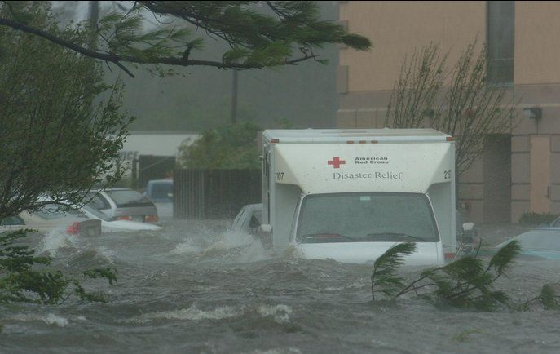
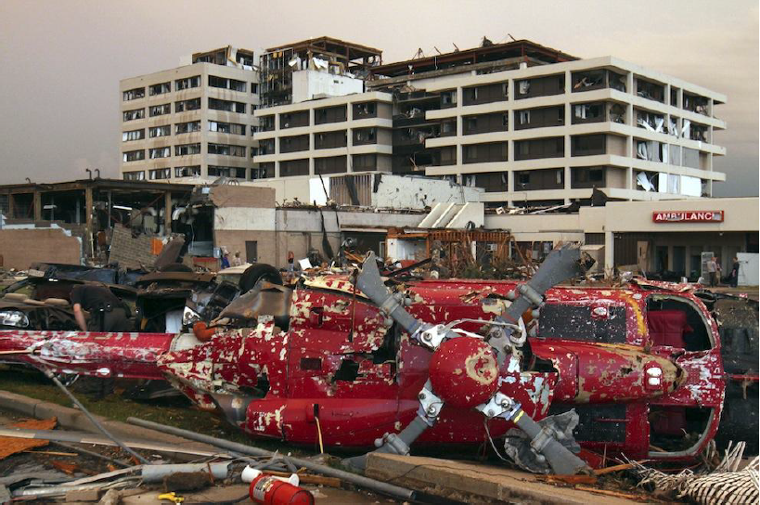
Emergency Management Overview
“An increased commitment to prepare for emergencies has historically never materialized until after the occurrence of a disaster.”

Slide 4
Emergency Management Overview
Emergency Management is:
Managerial function that creates the framework for organization to reduce hazards vulnerability and to cope with disasters
An integrated, all-hazards approach to manage emergencies utilizing response programs and activities
“How you prepare for one disaster or emergency situation is the same for any other disaster. Whether you represent a business or nonprofit organization, work for a state or local government, or want to prepare your family for disaster, preparedness can be achieved through thoughtful planning before a disaster.”

Slide 5
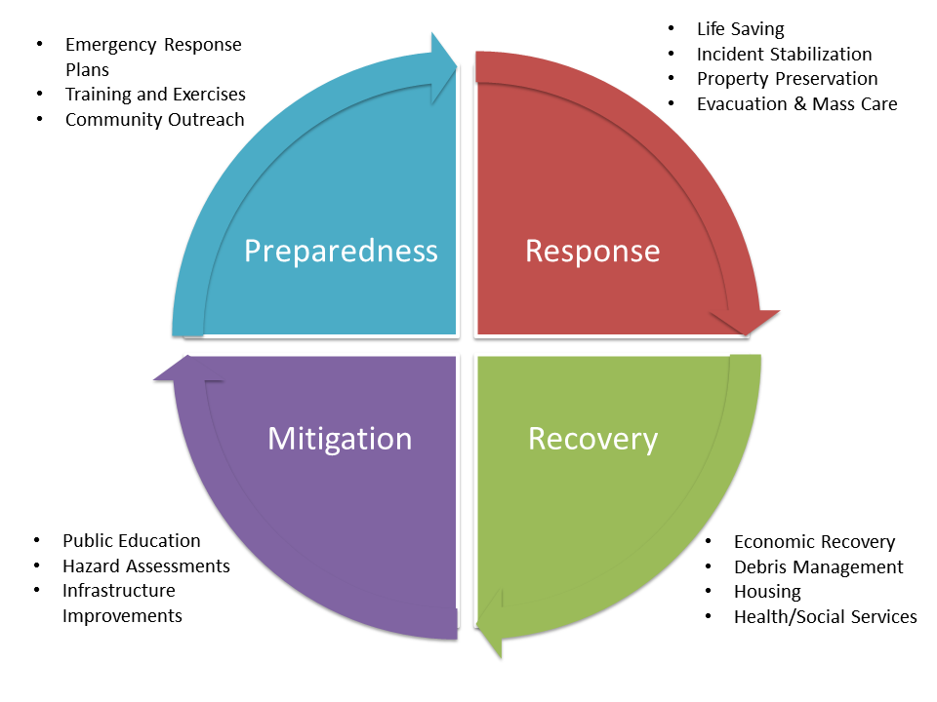
Emergency Management Overview

Slide 6
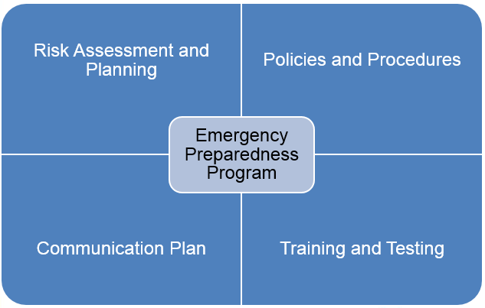
CMS EP Rule Update
Rule Overview:
Final rule published 16September16
Effective 15November16
Implemented 15November17
Focus on four major areas:
Emergency plan based on risk and hazard
Internal policies and procedures that specifically address subsistence needs, evacuation/shelter in place decision making
Communications plan
Training and testing program

Slide 7
Emergency Plan
Develop an emergency plan based on a community and facility all hazards risk assessment.
Perform and include documented risk assessments using an “all-hazards” approach, focusing on capacities and capabilities.
Update emergency plan at least annually.
Include strategies for addressing emergency events.
Address patient population.
Address Continuity of Operations (COOP)
Include a process for Cooperation and Collaboration with community partners in order to maintain an integrated response during a disaster or emergency.
9
Notes:
Plan must be based on a 1) documented risk assessment using an “all hazards approach.
The plan must:
2) Include strategies to address events identified in the risk assessment, plans for evacuating or sheltering in place, working with other providers in the area.
3) Address patient population; continuity of operations; succession planning.
4) A process for cooperation/collaboration with local, tribal, regional, state or Federal EP officials to ensure an integrated response.
The rule to allows a provider that is part of a healthcare system consisting of multiple separately certified healthcare facilities to have one unified and integrated emergency preparedness program. The integrated emergency plan and policies and procedures must be developed in a manner that takes into account each separately certified facility's unique circumstances, patient populations, services offered. In addition, a risk assessment must be conducted for each separately certified facility within the system.
Note: Each separately certified facility must – meet the COP on it’s own, meaning upon survey each facility is required to be able to demonstrate how they have met the requirements.

Slide 8
All-Hazards Approach:
An all-hazards approach is an integrated approach to emergency preparedness planning that focuses on capacities and capabilities that are critical to preparedness for a full spectrum of emergencies or disasters, including internal emergencies and a man-made emergency (or both) or natural disaster. This approach is specific to the location of the provider or supplier and considers the particular type of hazards most likely to occur in their areas. These may include, but are not limited to, care-related emergencies, equipment and power failures, interruptions in communications, including cyber-attacks, loss of a portion or all of a facility, and interruptions in the normal supply of essentials such as water and food.
7
Notes:
An all-hazards approach is an integrated approach to emergency preparedness planning that focuses on capacities and capabilities that are critical to preparedness for a full spectrum of emergencies or disasters, including internal emergencies and a man-made emergency (or both) or natural disaster. This approach is specific to the location of the provider or supplier and considers the particular type of hazards most likely to occur in their areas.
* Examples hurricane, floods, etc.

Slide 9
Policies and Procedures
Develop and implement policies and procedures based on the emergency plan and risk assessment.
Policies and procedures must address a range of issues including care and treatment of patients, subsistence needs, evacuation plans, evacuation location, procedures for sheltering in place, primary and secondary communications, Staff responsibilities, locating and tracking patients and staff/volunteers during an emergency.
Review and update policies and procedures at least annually.
10
Notes:
Policies and procedures must be based on the risk assessment and the emergency plan must address (highlights/full list in the regulations)
--provision of sub-sis-ten-ce needs, alternate energy sources, sewage and waste disposal, procedures for evacuating or sheltering in place
--system to track location of staff and patients (accurate, readily available, shareable)
--safe evacuation considerations –Care and treatment needs, transportation, ID evacuation location
--means to shelter in place – consider ability of building to survive a disaster and proactive steps that can be taken prior to an emergency
--system to preserve medical documentation (ensures confidentiality in compliance with HIPAA)
--use of volunteers and role of State and Federal Health Officials (suggest use of Medical Reserve Cops – ensure members are screened and trained in advance)
--Arrangements with other providers to receive patients in the event of limitation or cessation of operations as well as a method for sharing medical documentation with the receiving provider.

Slide 10
Communication Plan
Develop a communication plan that complies with both Federal and State laws.
Coordinate patient care within the facility, across health care providers, and with state and local public health departments and emergency management systems.
Must contain contact information for staff, entities providing services, patients’ physicians, volunteers, and community partners.
Provides a primary and secondary means for communicating with ASC’s Staff and emergency management officials at all levels.
Review and update plan annually.
11
Notes:
The Communication Plan must include
--names and contact info for staff, other hospitals, volunteers, State and local EP officials
--There also must be primary and alternate means of communicating with staff identified as well as how to contact EP officials and emergency management agencies
--method to share medical records and patient information including general condition and location

Slide 11
Training and Testing Program
Develop and maintain training and testing programs, including initial training in policies and procedures based on the emergency plan and risk assessment.
Demonstrate knowledge of emergency procedures and provide training at least annually. Documents of training and testing must be maintained.
Conduct drills and exercises to test the emergency plan.
Must be reviewed updated annually.
12
Notes:
Providers are required to conduct two testing exercises annually; one community based full-scale exercise and one additional exercise of their choice.
In the event that a provider experiences an actual emergency that tests their plan, they would be exempt from the requirement for a community based full-scale exercise for one year following the emergency event.
The regulation does allow for some flexibility for training and testing. For example, we require providers to conduct one community-based full-scale exercise and a second exercise of their choice. This will hopefully afford providers the flexibility to determine which testing exercise is most beneficial to them as they consider their specific needs.
--Full-Scale Exercise:
For purposes of the requirement for a community-based full-scale exercise, we expect facilities to simulate an anticipated response to an emergency involving their actual operations and the community.
This would involve the creation of scenarios, the engagement and education of personnel, and mock patients/victims. In addition, this would include the involvement of other providers, suppliers, and community emergency response agencies.
The intention of this requirement is to not only assess the feasibility of a provider's emergency plan through testing, but also to encourage providers to become engaged in their community and promote a more coordinated response within the facility, across health care providers, and with State and local public health departments and emergency systems.
When a community-based full-scale exercise is not available: We understand that participation in a community based full-scale exercise may not always be feasible or readily accessible.
Therefore, if a community-based full-scale exercise is not feasible, the requirement does provide providers with the flexibility to conduct a testing exercise that is based on the individual facility.

Slide 12
Training & Testing Requirements
Facilities are expected to meet all Training and Testing Requirements by the implementation date (11/15/17).
Participation in a full-scale exercise that is community-based or when a community-based exercise is not accessible, an individual, facility-based exercise.
A real world event will suffice as long as the emergency plan is activated and it is documented and an after action review/improvement plan is completed. (within 1yr of survey)
Conduct an additional exercise that may include, but is not limited to the following:
A second full-scale exercise that is individual, facility-based.
OR
A tabletop exercise that includes a group discussion led by a facilitator, using a narrated, clinically-relevant emergency scenario, and a set of problem statements, directed messages, or prepared questions designed to challenge an emergency plan.
12
Notes:
To emphasize, the implementation date of this Final Rule is November 15th this year. Meaning that facilities must meet and be able to demonstrate compliance by November. This includes having completed the training and exercise requirements.

Slide 13
Training & Testing Program Definitions
Facility-Based: When discussing the terms “all-hazards approach” and facility-based risk assessments, we consider the term “facility-based” to mean that the emergency preparedness program is specific to the facility. Facility-based includes, but is not limited to, hazards specific to a facility based on the geographic location; Patient/Resident/Client population; facility type and potential surrounding community assets (i.e. rural area versus a large metropolitan area).
Full-Scale Exercise: A full scale exercise is a multi-agency, multijurisdictional, multi-discipline exercise involving functional (for example, joint field office, emergency operation centers, etc.) and ‘‘boots on the ground’’ response (for example, firefighters decontaminating mock victims).
13
Notes:
On this slide, you will see the definitions and differences between what CMS considers a facility based exercise and a full scale exercise.
Facility-based includes, but is not limited to, hazards specific to a facility based on the geographic location, taking into account the patient population.
Full-Scale exercise is an operations based exercise which typically involves multiple agencies and disciplines and incorporates the requirements for facilities to coordinate and collaborate with their state and local emergency officials.
The Final Rule requires facilities to participate in a full-scale exercise that is community-based or when not available or accessible, the facility may conduct an individual facility-based exercise.

Slide 14
Training & Testing Program Definitions
Table-top Exercise (TTX): A table-top exercise is a group discussion led by a facilitator, using narrated, clinically-relevant emergency scenario, and a set of problem statements, directed messages, or prepared questions designed to challenge an emergency plan. It involves key personnel discussing simulated scenarios, including computer-simulated exercises, in an informal setting. TTXs can be used to assess plans, policies, and procedures.
14
Notes:
On this slide, you see our definition for the table top exercise. It may be in the best interest of a facility to start with a table top exercise before conducting a full-scale exercises to be able to assess its capabilities and potential effectiveness of its program.

Slide 15
New for Long Term Care (2017)
2017 Edition of NFPA 70.
Chapter 7 Special Conditions
Article 700 Emergency Systems
(F) Temporary Source of Power for Maintenance or Repair of the Alternate Source of Power.
If the emergency system relies on a single alternate source of power, which will be disabled for maintenance or repair, the emergency system shall include permanent switching means to connect a portable or temporary alternate source of power, which shall be available for the duration of the maintenance or repair.

Slide 16
Program Overview

Slide 17
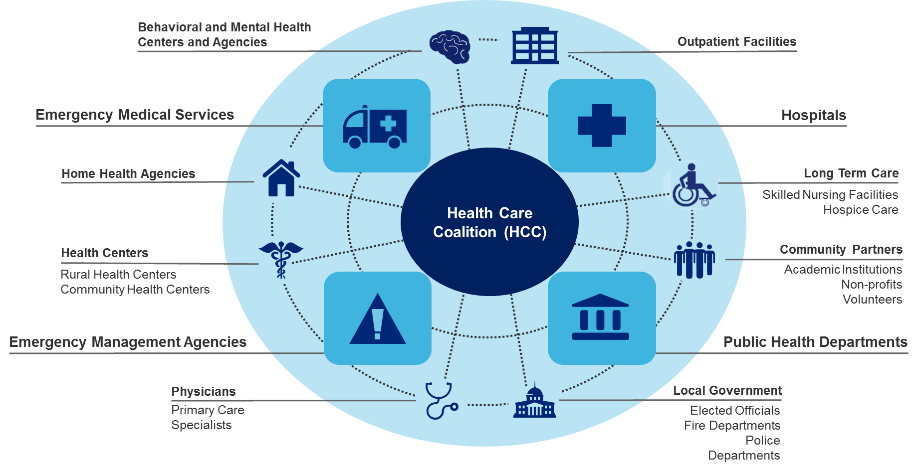
Program Overview

Slide 18
Program Overview
North Carolina Healthcare Preparedness, Response, and Recovery Program:
Partnering For a Prepared and Resilient North Carolina
Mission:
We are a partner to healthcare and emergency response organizations working to prepare for, mitigate, respond to, and recover from emergencies and disasters affecting the residents and guests of North Carolina.
Vision:
A sustainable and resilient healthcare coalition of partners and volunteers.
Values:
Advocacy Innovation Transparency Integrity
Goals:
Strengthen Healthcare Infrastructure Preparedness Support Business Continuity Enhance Situational Awareness Improve Incident Management Augment Medical Surge Capability

Slide 19
Program Overview
Alleghany
C
u
r
Northampton
C
r
i
Gates
a
t
Ashe
Surry
P
u
Caswell
Person
a
m
c
Stokes
Rockingham
Vance
Warren
s
q
d
k
Granville
P
u
e
Hertford
e
o
t
n
r
a
q
n
Halifax
u
Watauga
i
k
Wilkes
m
C
a
Yadkin
h
n
Forsyth
o
s
M
Bertie
w
i
Guilford
Orange
Franklin
a
t
Avery
Alamance
n
c
h
Durham
e
l
Madison
Yancey
l
Caldwell
Alexander
Davie
Nash
Edgecombe
Burke
Iredell
Davidson
Chatham
Wake
Martin
Washington
Tyrell
Dare
Haywood
Buncombe
McDowell
Catawba
Rowan
Randolph
Wilson
Pitt
Beaufort
Swain
Rutherford
Lincoln
Lee
Johnston
Greene
Hyde
Graham
Jackson
Henderson
Polk
Gaston
Cabarrus
Stanly
Moore
Harnett
Wayne
Macon
s
y
l
v
a
n
i
a
Cleveland
Mecklenburg
Montgomery
Lenoir
Craven
Cherokee
r
a
n
Clay
T
Richmond
Cumberland
Sampson
Jones
Pamlico
Union
Anson
Hoke
Duplin
Scotland
Onslow
Carteret
Robeson
Bladen
Pender
Columbus
New
Hanover
Brunswick
 | Mountain Area Healthcare Preparedness Coalition |  | Mid Carolina Regional Healthcare Coalition
 | Triad Healthcare Preparedness Coalition |  | CapRAC Healthcare Coalition
 | Metrolina Healthcare Preparedness Coalition |  | Eastern Healthcare Preparedness Coalition
 | Duke Healthcare Preparedness Coalition |  | Southeastern Healthcare Preparedness Region

Slide 20
Program Overview
2004: Contracted with existing Trauma Regions (Regional Advisory Committees) for disaster preparedness activity
2006: Began a move to a more regional approach
Focus at that time was primarily on response and grant management
2012: Conducted federally-directed assessment of system based on Whole Community approach
2014: Transition to healthcare preparedness regions/healthcare coalitions with focus on broader healthcare infrastructure protection and support

Slide 21
Program Overview-Triad HPC
Triad Healthcare Preparedness Coalition meetings are the 1st Thursday of every even month from 1PM till 3PM. Register on TERMS. Webinar meeting is available.
Regional exercises and trainings.
Stakeholder support for meetings and conferences.
Subject Matter Expert (SME) assistance and support.
Healthcare Facility Support
Home of the Triad State Medical Assistance Team

Slide 22
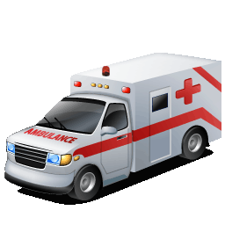
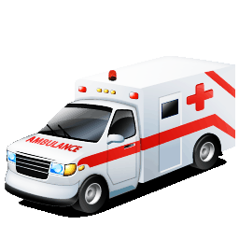
Program Overview
Alleghany
C
u
r
Northampton
C
r
i
Gates
a
t
Ashe
Surry
P
u
Caswell
Person
a
m
c
Stokes
Rockingham
Vance
Warren
s
q
d
k
Granville
P
u
e
Hertford
e
o
t
n
r
a
q
n
Halifax
u
Watauga
i
k
Wilkes
m
C
a
Yadkin
h
n
Forsyth
o
s
M
Bertie
w
i
Guilford
Orange
Franklin
a
t
Avery
Alamance
n
c
h
Durham
e
l
Yancey
l
Caldwell
Alexander
Davie
Nash
Edgecombe
Madison
Iredell
Davidson
Wake
Martin
Washington
Tyrell
Dare
McDowell
Burke
Catawba
Randolph
Chatham
Wilson
Haywood
Buncombe
Rowan
Pitt
Beaufort
Hyde
Swain
Rutherford
Lincoln
Lee
Johnston
Greene
Graham
Jackson
Henderson
Cabarrus
Stanly
Moore
Harnett
Wayne
y
l
v
a
n
i
a
Polk
Cleveland
Gaston
Mecklenburg
Montgomery
Lenoir
Craven
Cherokee
Macon
r
a
n
s
Clay
T
Richmond
Cumberland
Sampson
Jones
Pamlico
Union
Anson
Hoke
Duplin
SMAT II
SMAT III
AST
AMBULANCE BUS
Scotland
Onslow
Carteret
Robeson
Bladen
Pender
Columbus
New
Hanover
Brunswick

Slide 23
Program Overview
Primary SMRS/Regional Operational Missions:
Medical Sheltering
Field Medical Care
Alternate Care Facility
Logistical/resource support
Secondary SMRS/Regional Operational Missions:
First-receiver decontamination operations
POD operational support
Isolation/quarantine support
Incident Management support

Slide 24
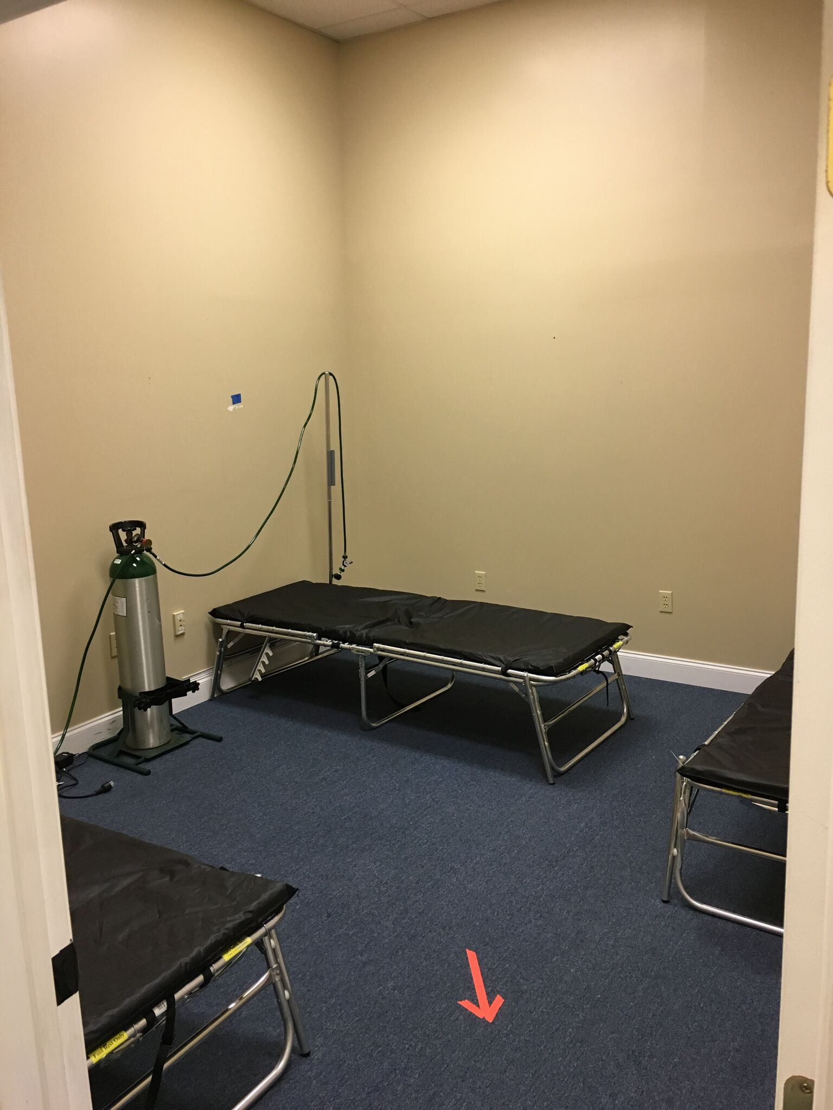

Slide 25
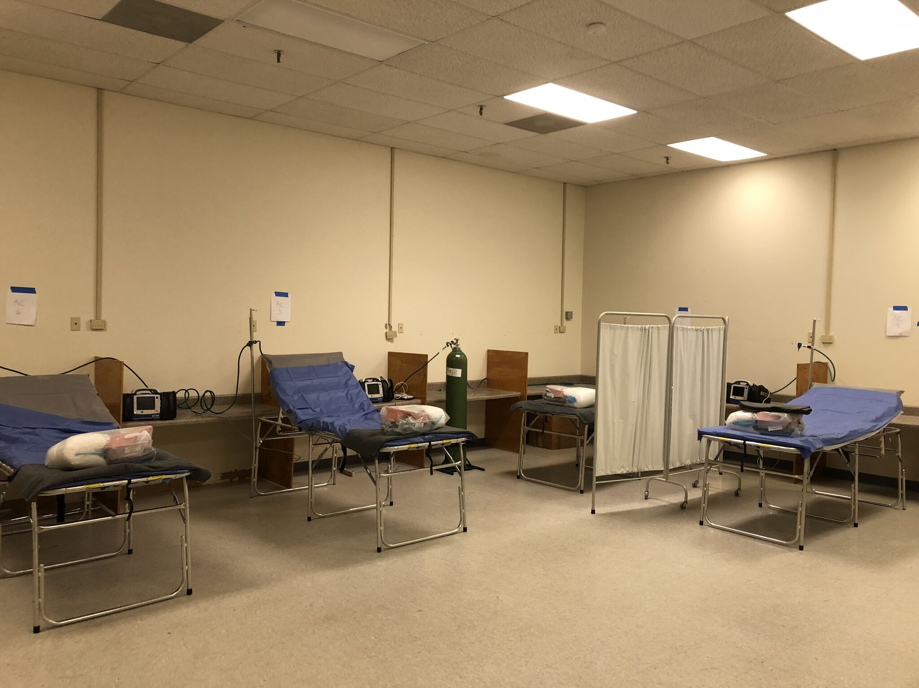

Slide 26
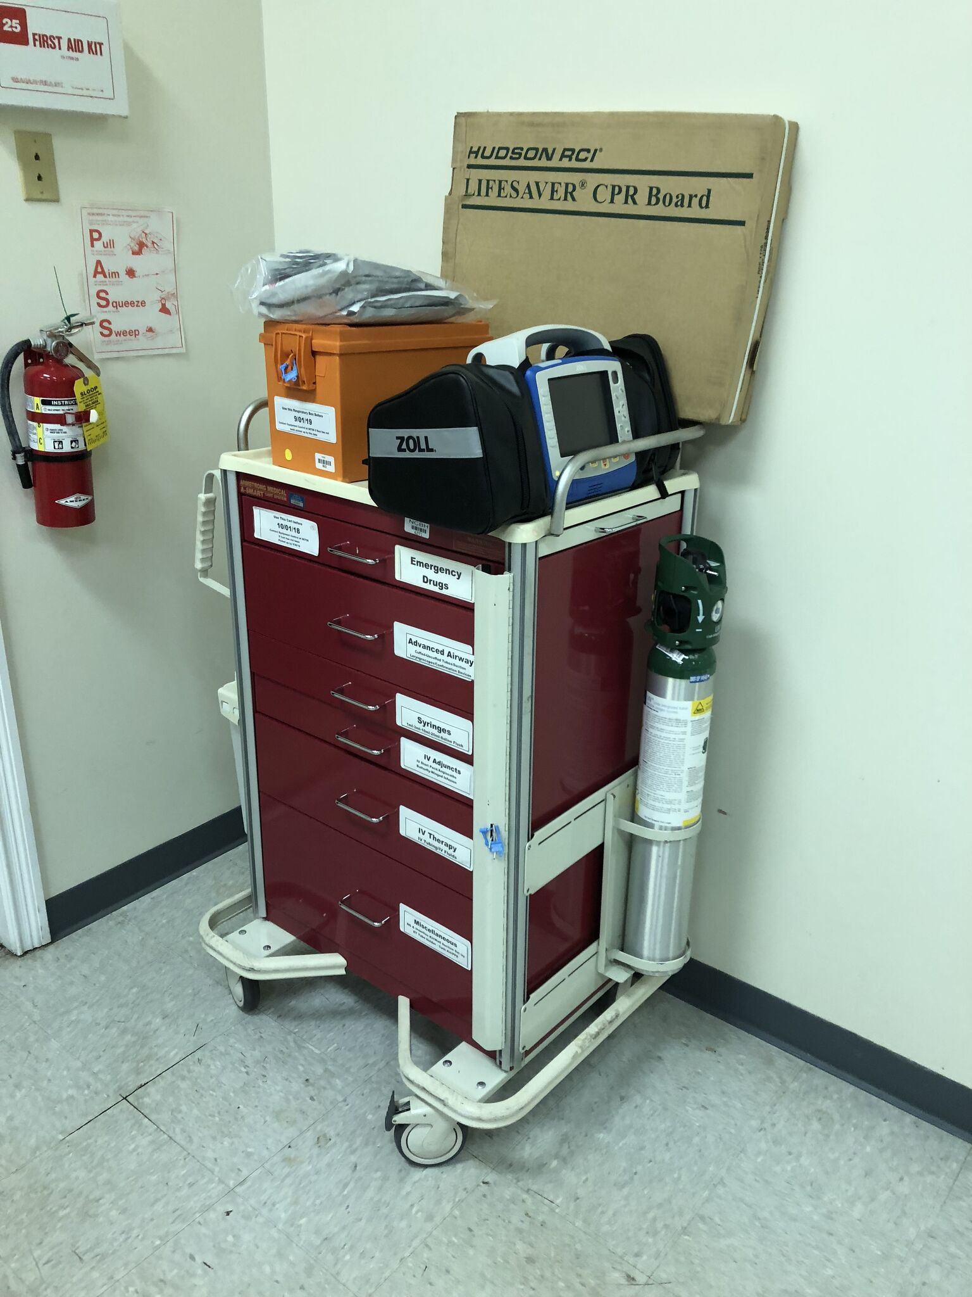

Slide 27
Program Overview

Slide 28
Program Overview

Slide 29
Program Overview

Slide 31
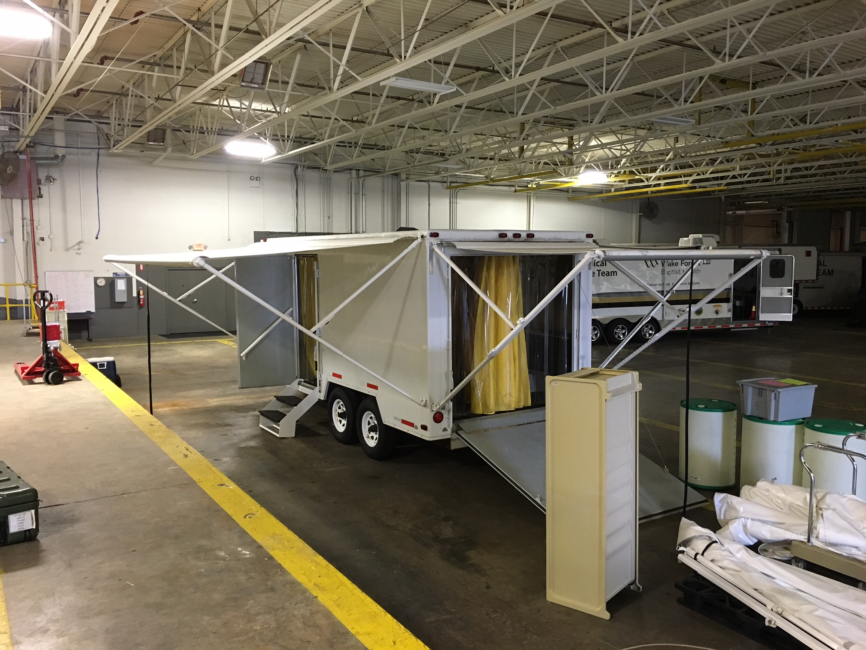

Slide 32
Recovery
Supplement damaged infrastructure
Generator power
Water purification
Transportation Support
Mobile shelters and facilities
HVAC emergency support
Outside lighting
Morgue and Mass Fatality support
Assets are frequently used for minor regional emergencies

Slide 33
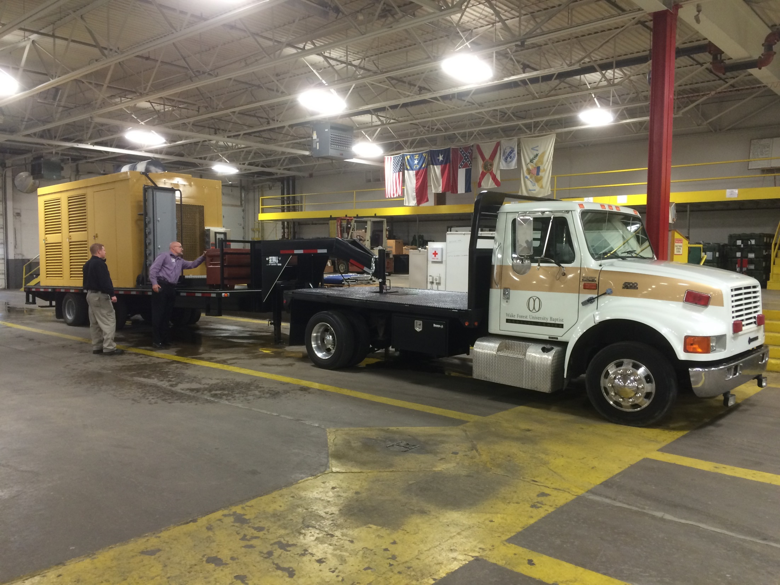

Slide 34
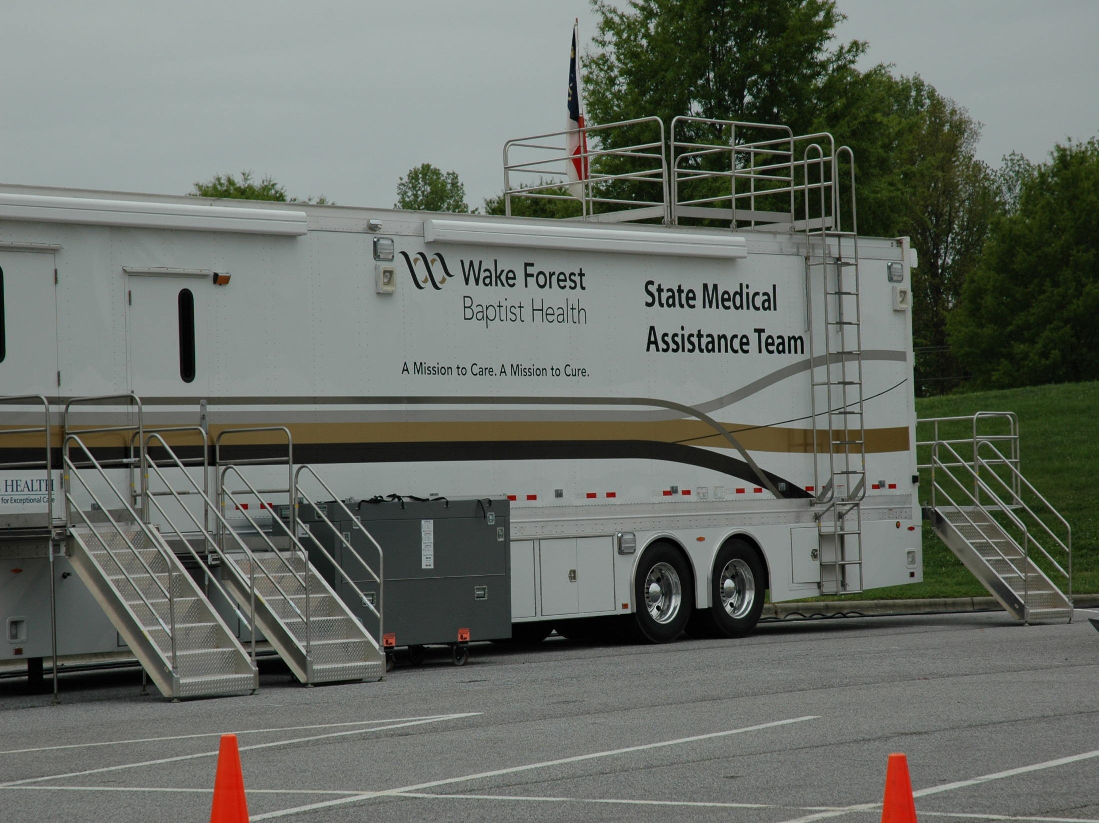

Slide 35
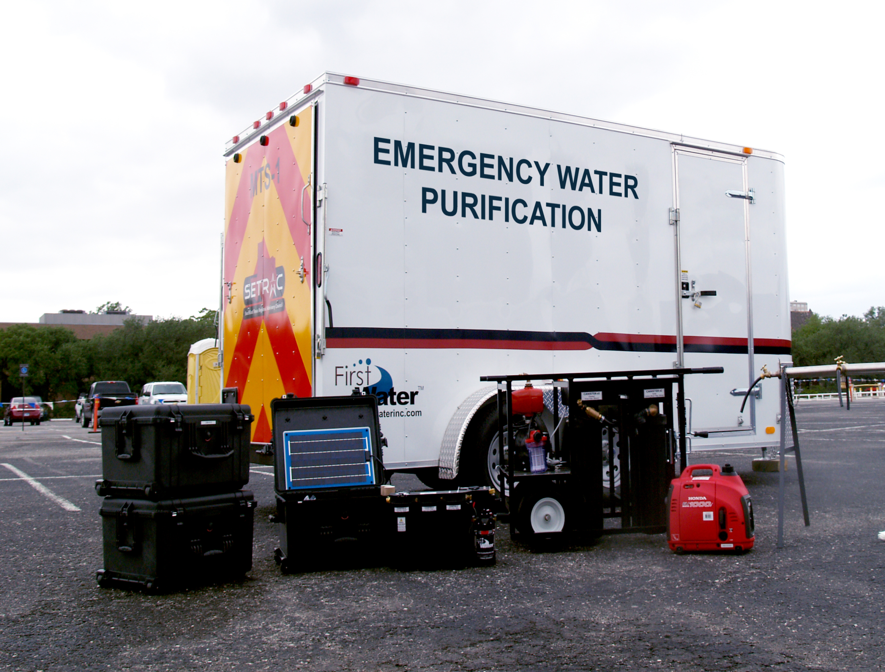

Slide 38
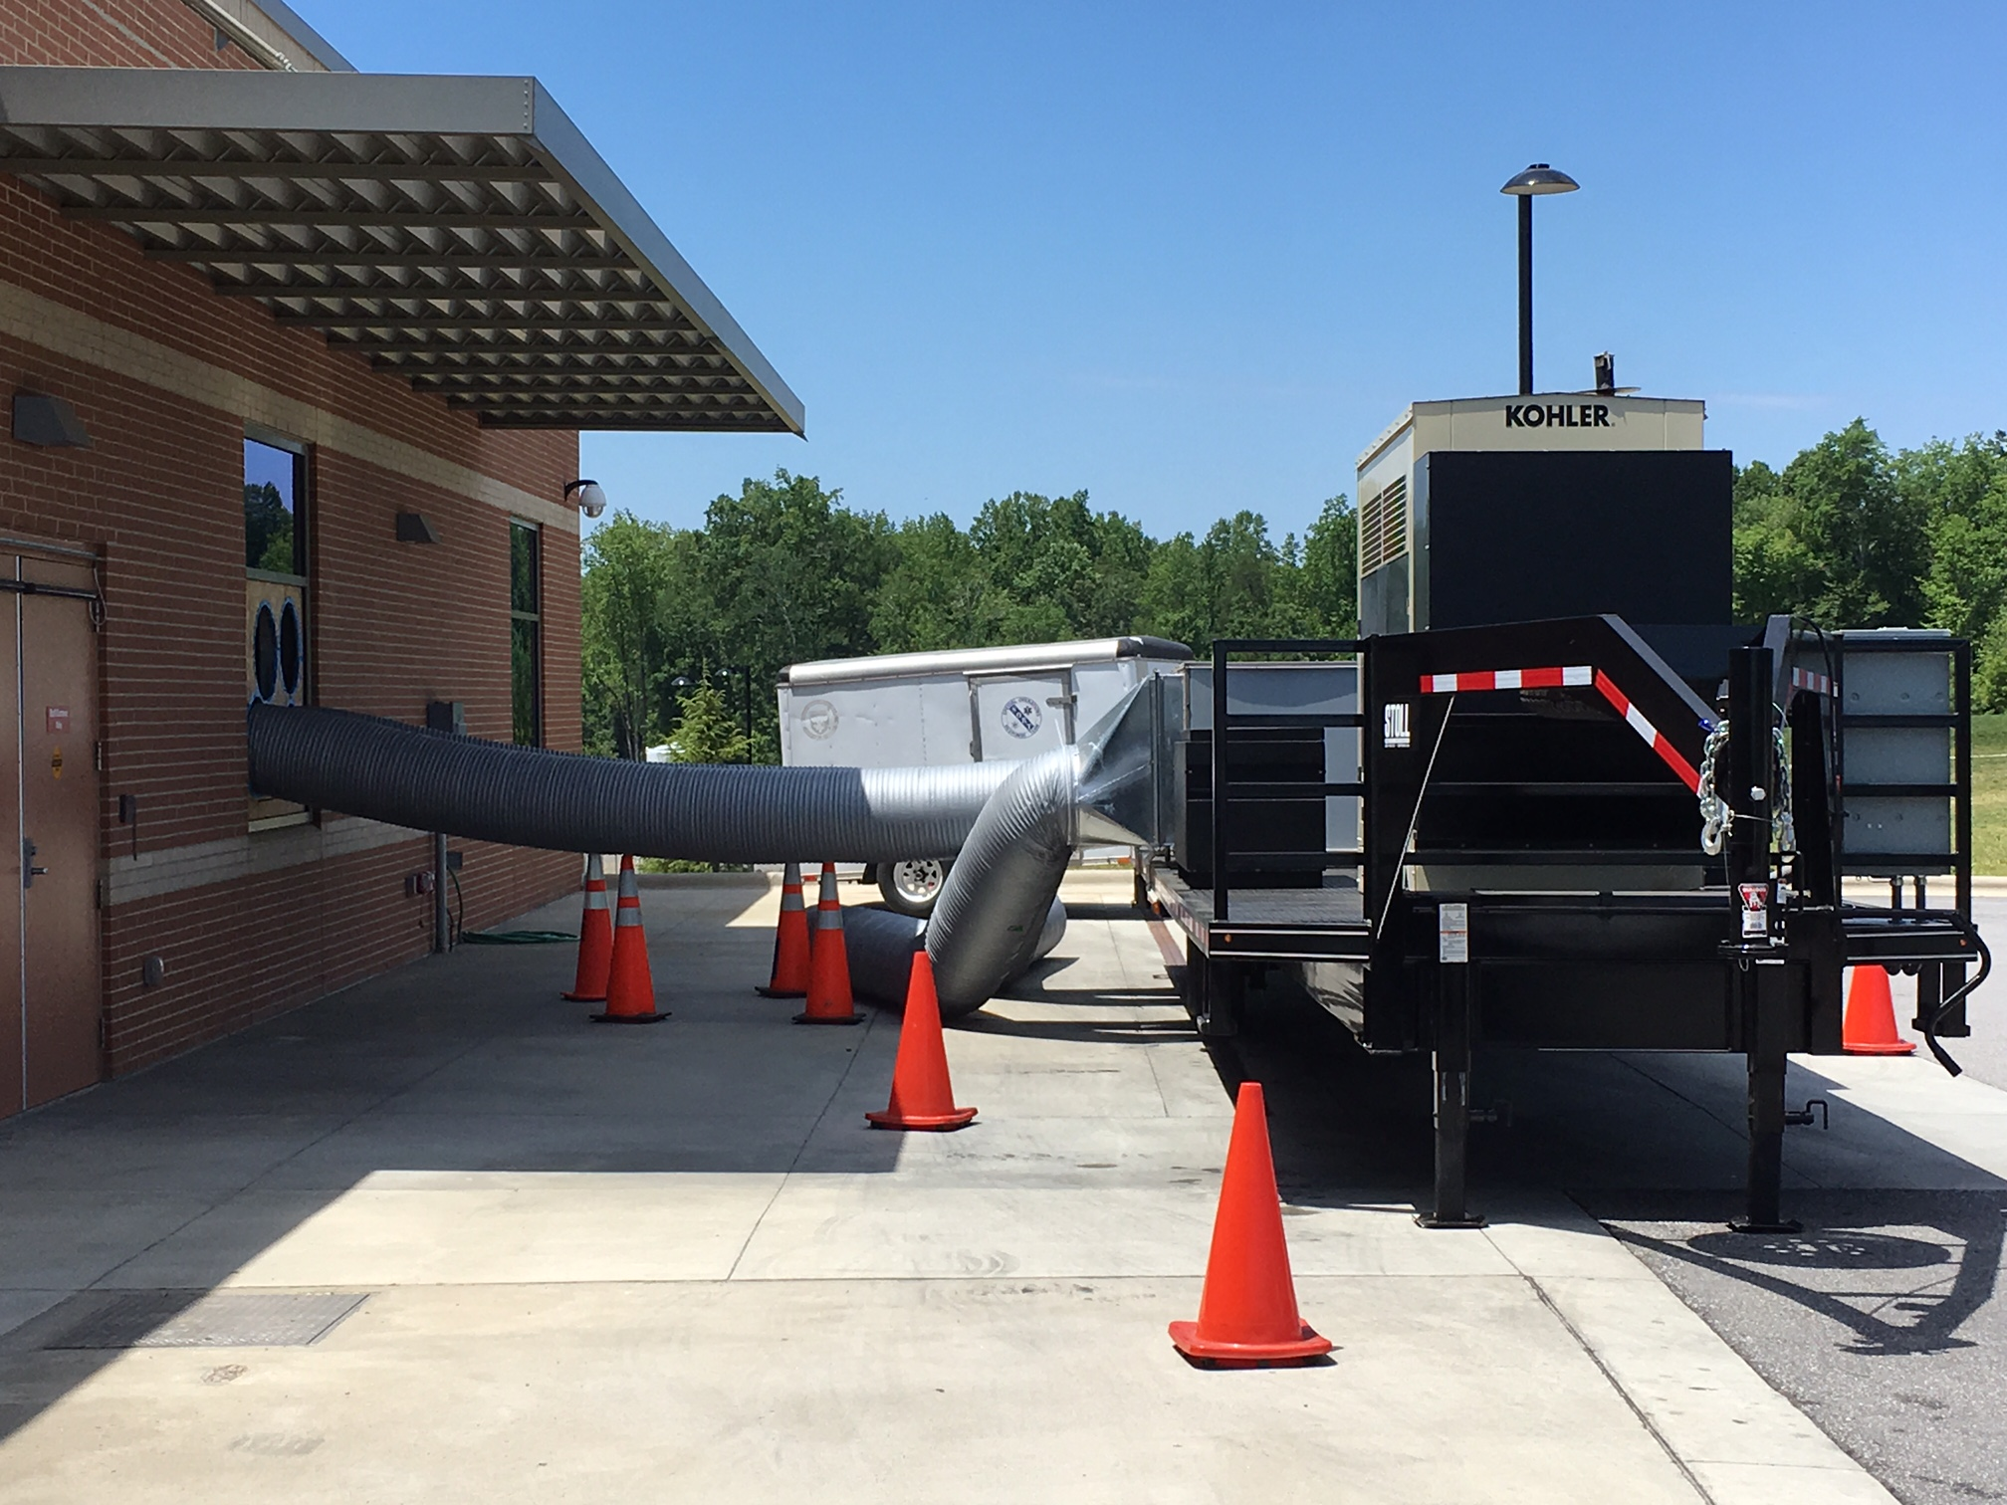

Slide 39
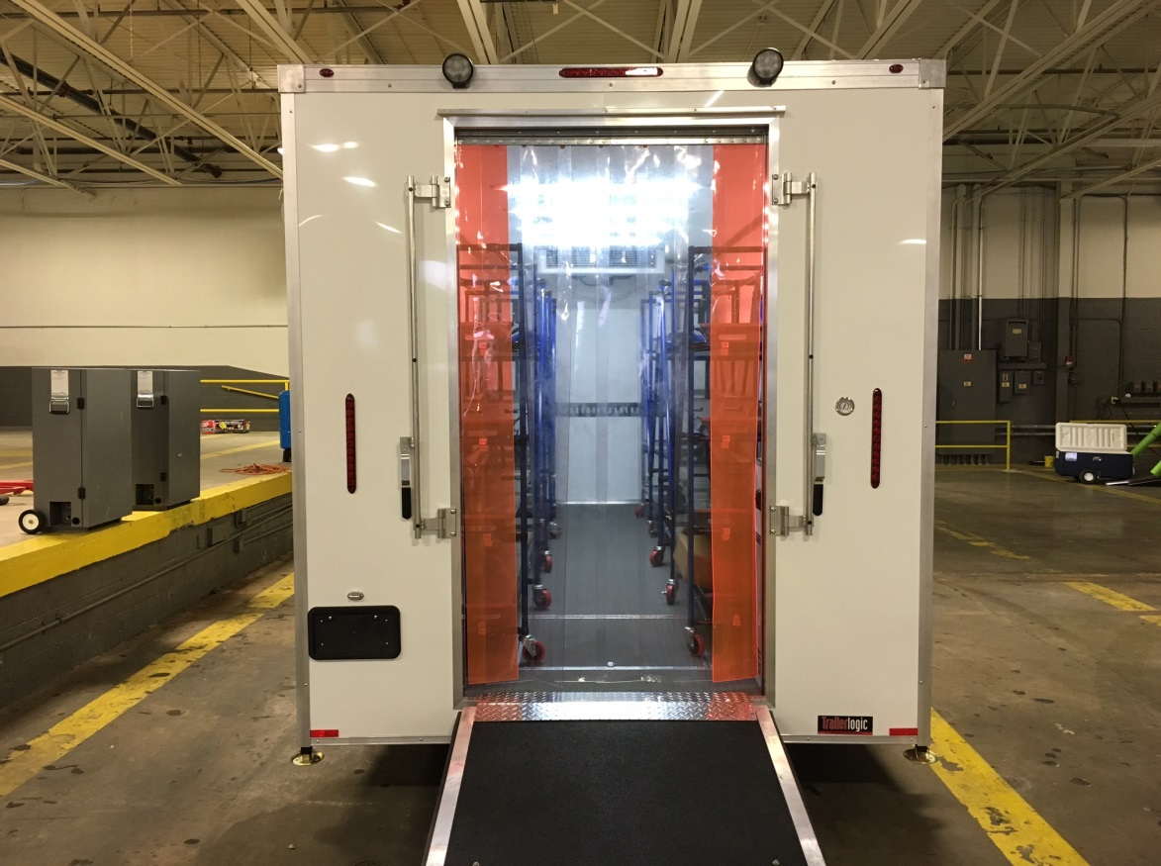
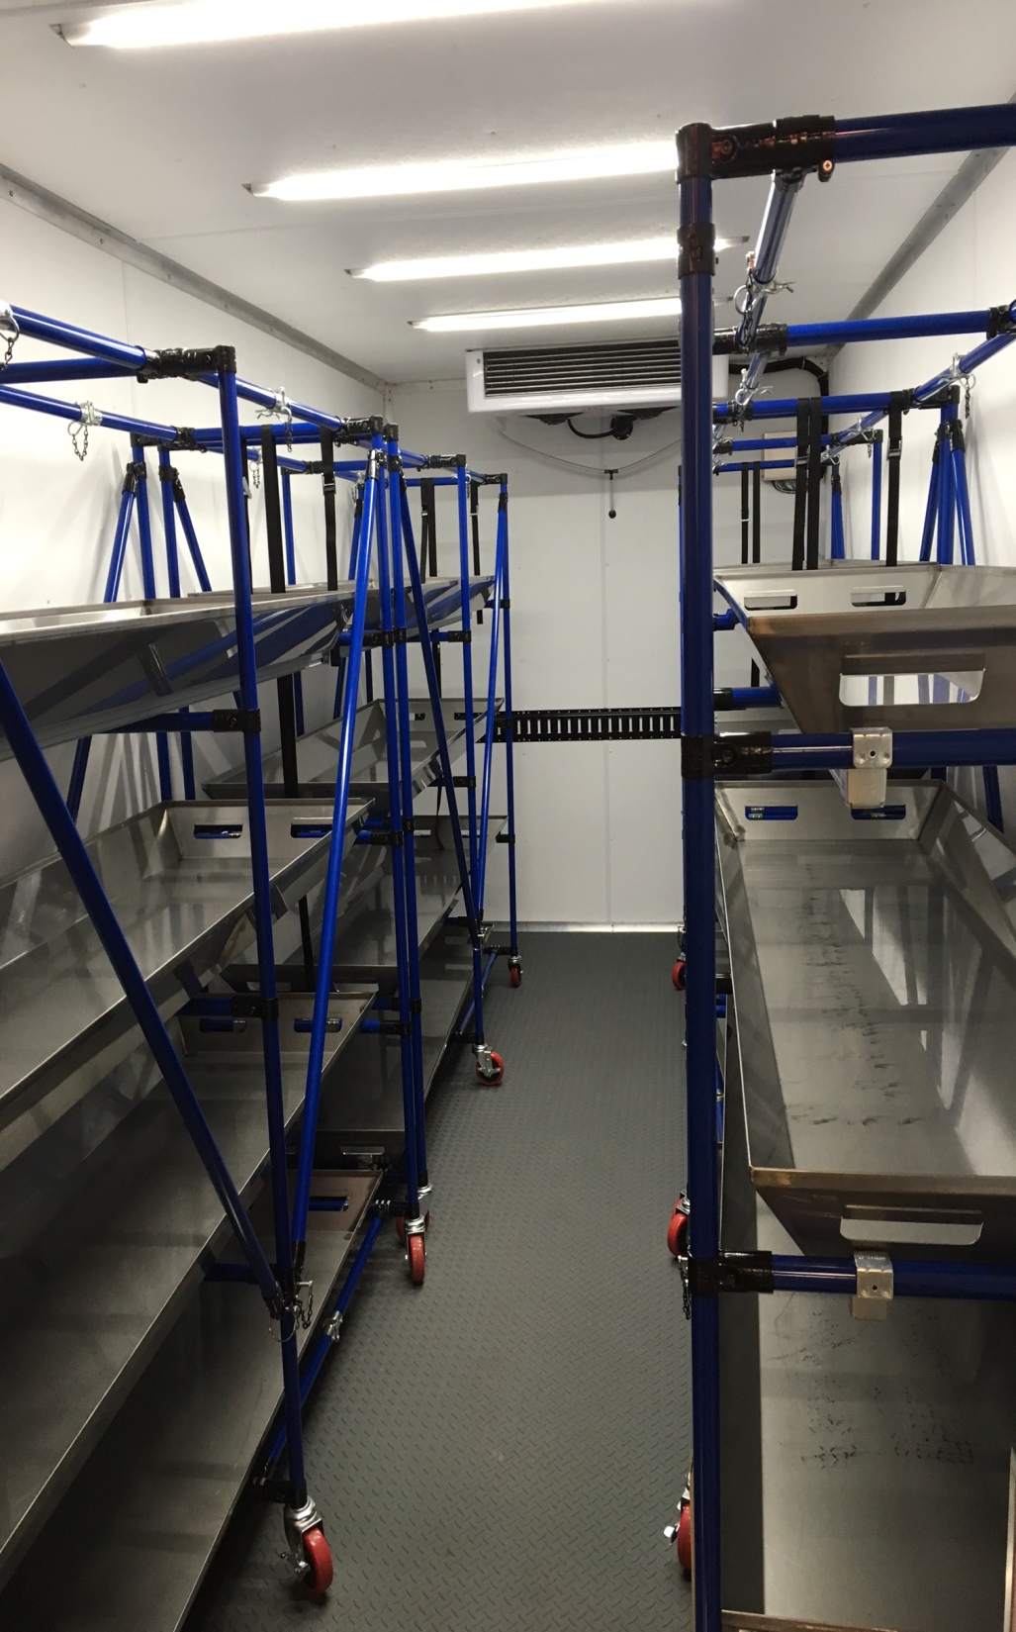
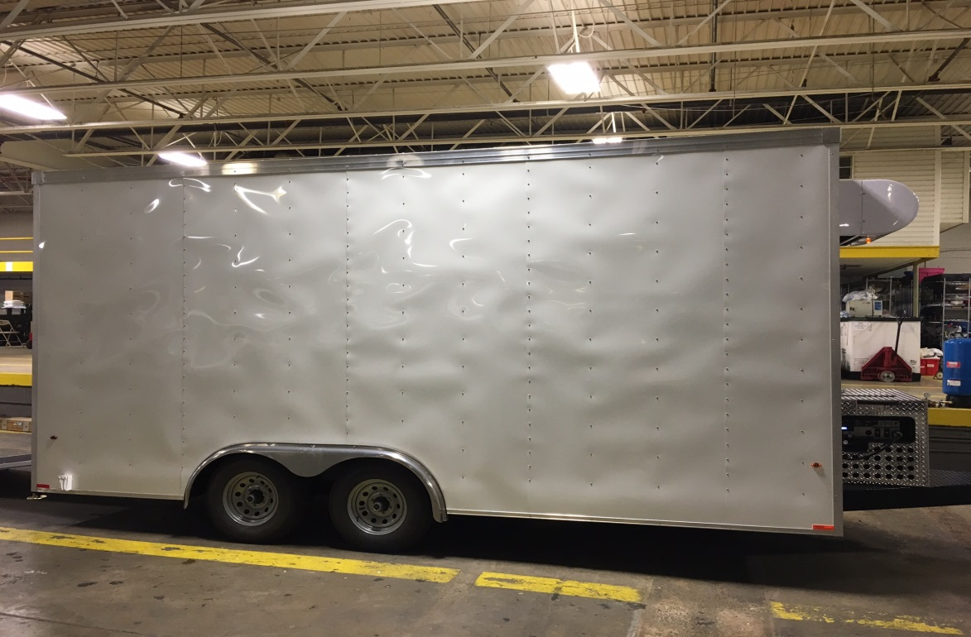

Slide 40
Program Overview
Mobile Disaster Hospital:
Mission: The Mobile Disaster Hospital (MDH), located in North Carolina under the auspices of the North Carolina Office of Emergency Medical Services (NCOEMS), is a medical continuity of operations asset to aid in the recovery of healthcare infrastructure and support community resiliency in times of a disaster.
Operational Capabilities:
Two (2) 5-bed Mobile ED (Hard Structure)
21-bed Emergency Department (Soft Structure) w/ x-ray unit, clinical lab, pharmacy, and medical supply (Hard Structures) and logistical support (Soft Structures)
12-bed ICU w/ medical supply and logistical support unit (Hard Structures)
One (1) Operating Room including C-Arm and Operating Microscope w/ surgical processing, medical supply, and logistical support (Hard Structures)

Slide 41
Program Overview

Slide 42
Program Overview

Slide 43
Program Overview

Slide 44
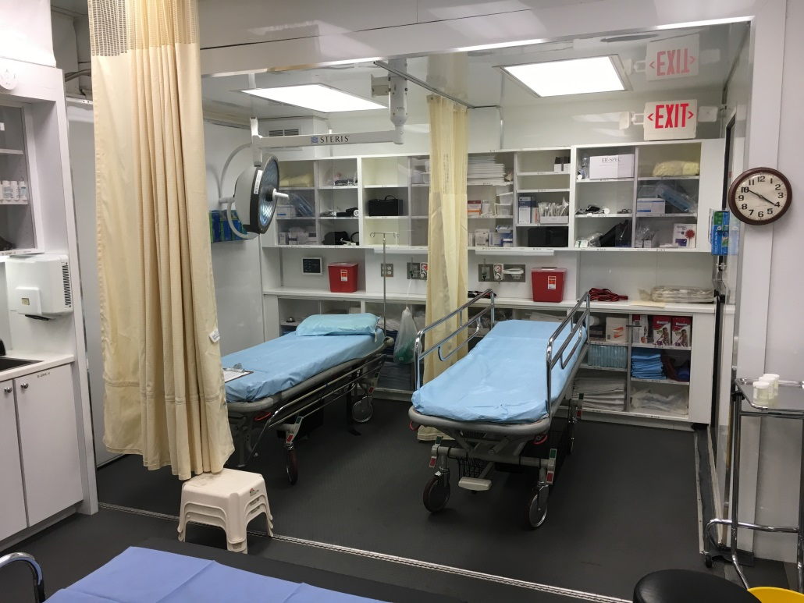
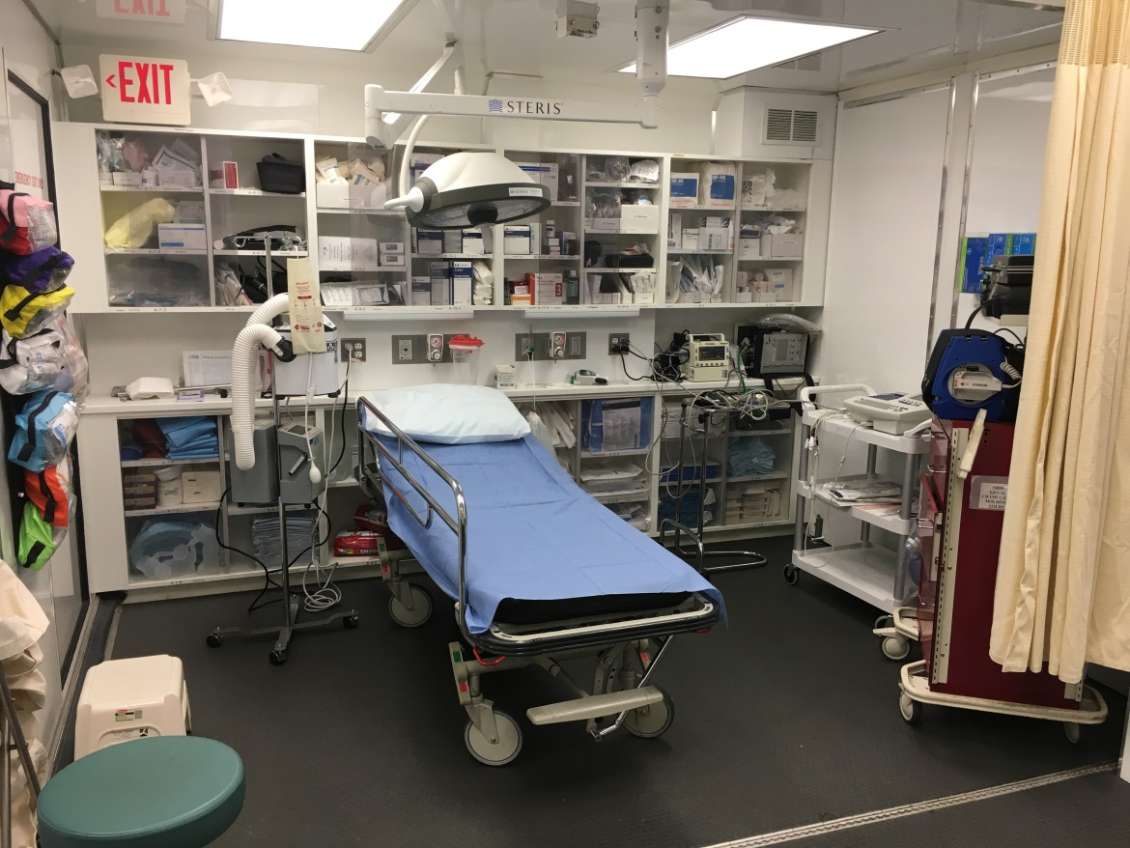
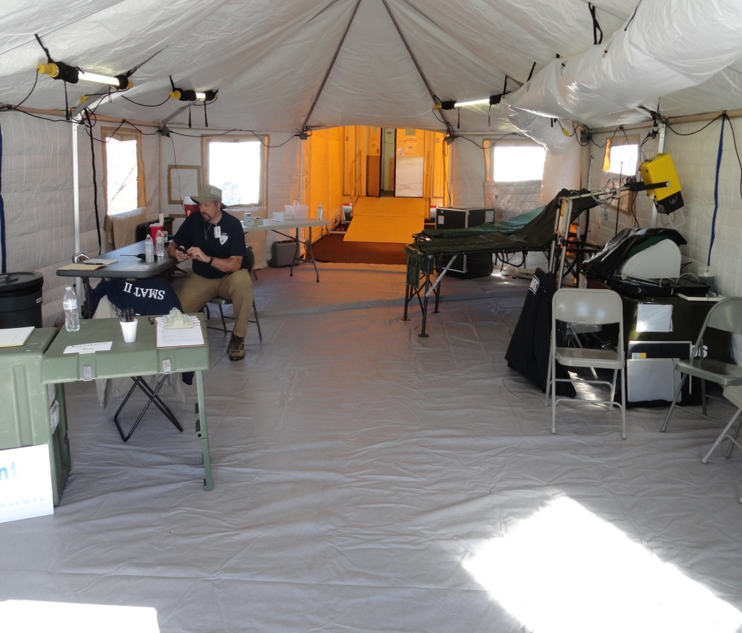

Slide 45
Contact Information
Triad Healthcare Preparedness Coalition
Corey D. Roberts Healthcare Preparedness Planner
Cdrobert@wakehealth.edu
1-336-701-6080 Emergency Support
1-336-702-1901 Office
315 Bethel Church Rd.
Mocksville, NC 27028

Slide 46
Questions

